Slide 1
How to Use WebEx Meetings and an Introduction to Online Learning
The ACE Team
The session will start at ….
Please check your speakers are working. If you are having difficulties seeing the screen or hearing, sign out and back in again. ​
​Please mute your microphone/phone when joining the session. You can unmute yourself when necessary.​

Slide 2
The ACE Team
Objectives
To learn to use the main features and functions of Webex
To explore differences between learning online and in the classroom
To develop strategies for effective online learning

Slide 3
Mute/unmute
The ACE Team

Slide 4
Turn your camera on/off
The ACE Team

Slide 5
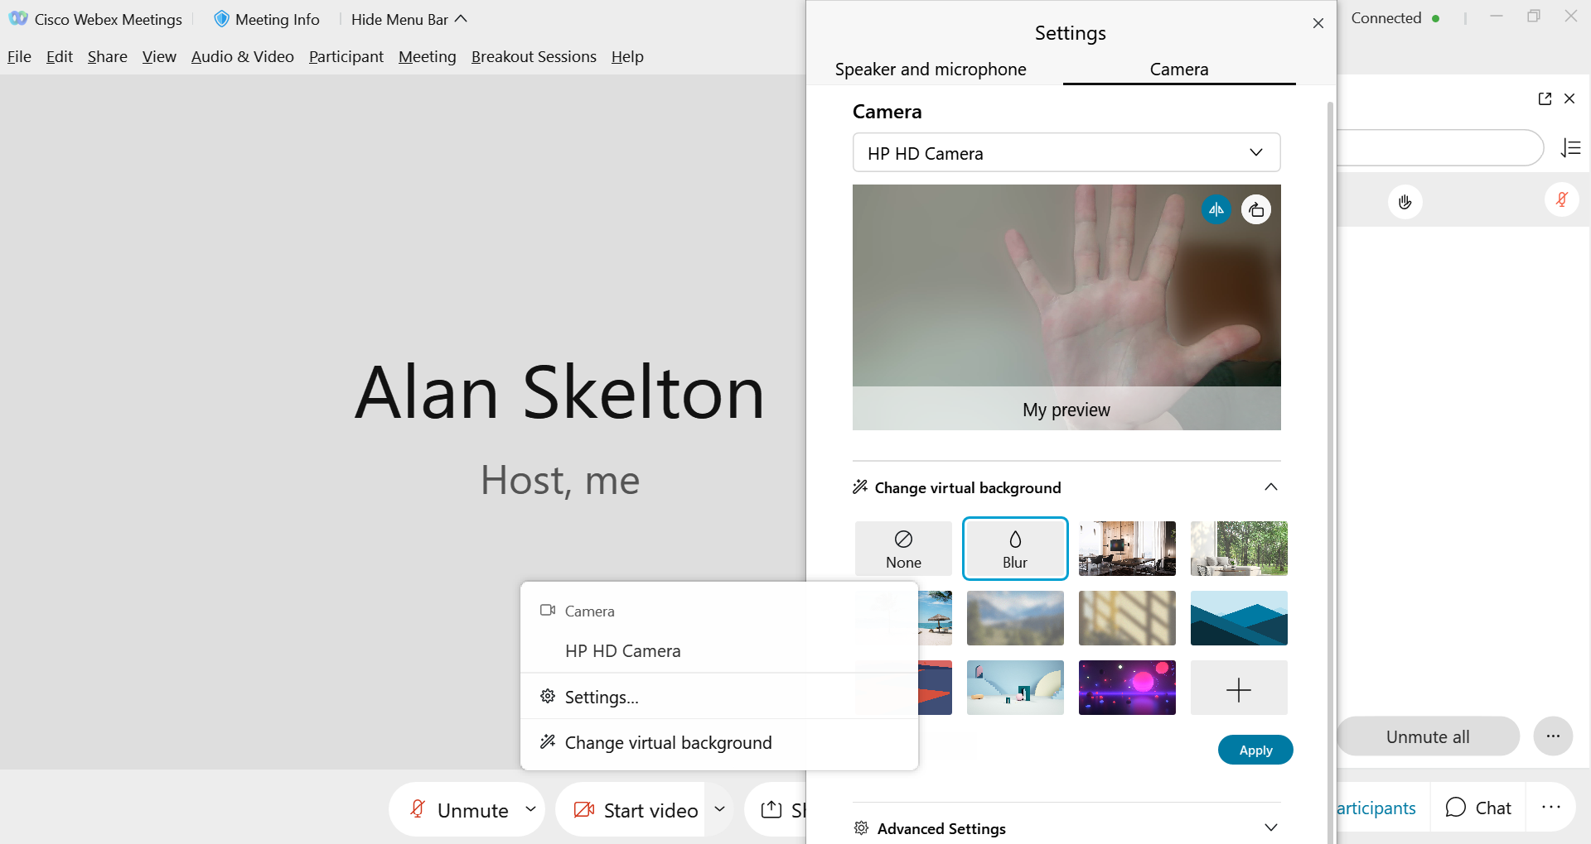
Blur your background
The ACE Team

Slide 6
Use the captions
The ACE Team

Slide 7
Put your hand up/down
The ACE Team

Slide 8
Use a reaction emoji
The ACE Team

Slide 9
Message everyone
The ACE Team

Slide 10
Message the teacher
The ACE Team

Slide 11
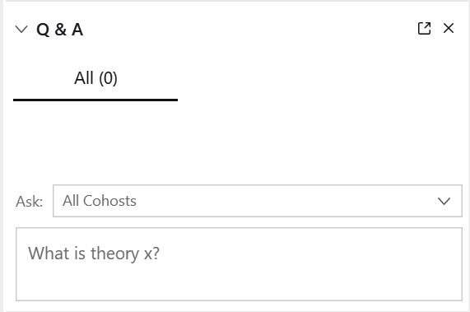
Ask a question using the Q&A feature
The ACE Team

Slide 12
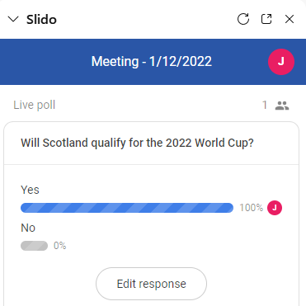
Answer a question using Slido
The ACE Team

Slide 13
Annotate the whiteboard
The ACE Team

Slide 14
How does online learning differ from learning in the classroom? Share your ideas below:
The ACE Team

Slide 15
Sense of Academic Community
The ACE Team
Peer support groups and student-led initiatives
Opportunities to socialize outside class
Drop-in sessions and office hours
(McGill, 2020)

Slide 16
Digital Distractions
The ACE Team
Difficulties in maintaining focus
Reduced productivity and wasted time
Increased multi-tasking
(Harvard Business Review, 2015)
(Skills4Trainers, 2014)

Slide 17
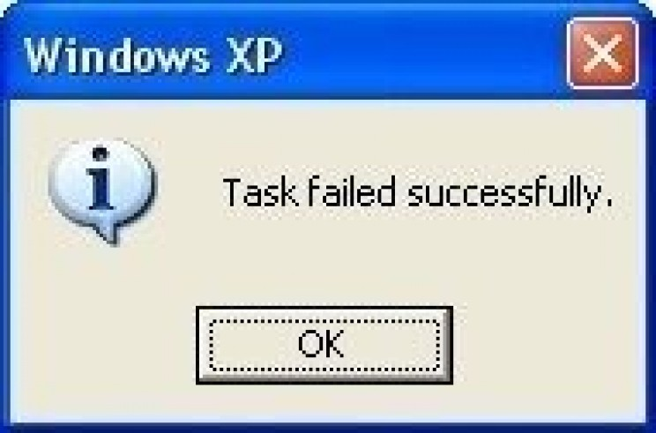
Communication Issues Online
The ACE Team
Audio/webcam problems
Lag in communications
Teacher-centred classroom

Slide 18
The ACE Team
In breakout sessions please introduce yourself, say what you are studying and why.
Then discuss tips for effective online learning for one of the following:
Creating an academic community
Creating a good working environment
Using your study time most effectively
Preserving proper online etiquette

Slide 19
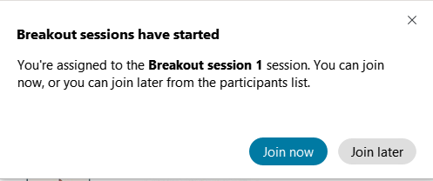
Breakout Sessions
The ACE Team
You will see this pop-up window:

Slide 20
Breakout Sessions
The ACE Team

Slide 21
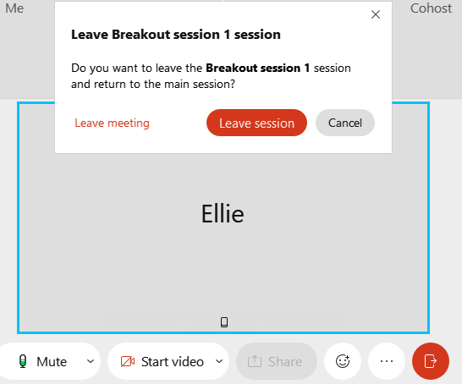
Breakout Sessions
The ACE Team

Slide 22
The ACE Team
In breakout sessions please introduce yourself, say what you are studying and why.
Then discuss tips for effective online learning for one of the following:
Creating an academic community
Creating a good working environment
Using your study time most effectively
Preserving proper online etiquette

Slide 23
The ACE Team
Post-task Apply one of the online learning strategies discussed to your own studies. For example:
Create a social media group for your class
Download a free time management app
Create Microsoft OneNote folders for taking notes
Anything else we’ve discussed that you’ve found useful!

Slide 24
Reference list/further resources
The ACE Team
Joyce, L. (2020) Tips for Successful Online Learning. edX. 16 March. Available at: https://blog.edx.org/tips-for-successful-online-learning (Accessed: 10 June 2020).
McGill University (2020) Intellectual climate and academic community. Available at: https://www.mcgill.ca/gradsupervision/supervisees/intellectual-climate (Accessed: 10 June 2020).
Rosen, L. and Samuel, A. (2015) Conquering Digital Distraction. Available at: https://hbr.org/2015/06/conquering-digital-distraction (Accessed: 10 June 2020).
Skills4Trainers (2014) Digital Distraction - how to manage distractions while learning. Available at: http://skills4trainers.blogspot.com/2014/03/digital-distraction-how-to-manage.html (Accessed: 9 June 2020).

Slide 25
The ACE Team
Get in touch
Book a workshop
Email aceda@qa.com
Call 0207 656 8446
Book a one to one tutorial

Slide 26
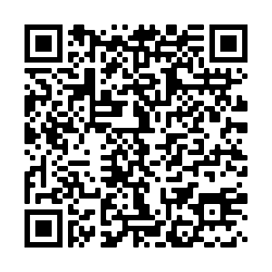
Thank you for attending the Study Strategies for New Learners workshop today. We would be grateful if you could take 5 minutes to complete our feedback form.
Via the URL in the Chat Box
By scanning the QR Code
Notes:
https://forms.office.com/Pages/ResponsePage.aspx?id=lwcinDfD-EmwhqmiSXn3KJx4-QmcBv9NnNg4SAsynGNUMDRJTEhHQ1RYSVVMQVZCNjhBMlpMNExDTi4u
26

