Slide 1
The ACE Team
Getting started on your assignment
The session will start at ….
Please check your speakers are working. If you are having difficulties seeing the screen or hearing, sign out and in again.
Please mute your microphone/phone when joining the session. You can unmute yourself when necessary.

Slide 2
The ACE Team
What is difficult about getting started?

Slide 3
Today’s topics
The ACE Team
Some obstacles and some possible strategies:
Time
Finding information
Finding your thread
Making a start

Slide 4
Common difficulties in getting started
The ACE Team
Time | Missing information | Finding your thread | Making a start
Lack of time Panic Tiredness Getting behind with the weekly reading Intending to go back and make detailed notes later Duplicating effort Leaving it late to start writing | Not sure what is expected Looking but not finding information Missed classes containing key information and guidance Forgotten what’s in the brief | Too many ideas / too much information Don't know what to put in and what to leave out Don't know what the 'message' is | Worried your text won't be good enough The first sentence

Slide 5
Time – not enough, not good-quality
The ACE Team
Top tips?

Slide 6
The ACE Team
Making the most of your time
Getting organised
Setting up systems, routines and files
Allocating time for all stages / aspects
Using available pieces of time efficiently (Rocks, Pebbles, Sand?)
Start early
Avoid duplication of effort
Have a notebook or Word doc for thoughts that occur during the day
Plan times for relaxation and take them
Ask for help if you need it

Slide 7
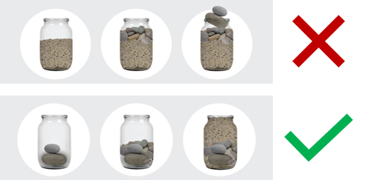
Making the most of your time: Rocks, Pebbles, Sand
The ACE Team
Figure 1: Image of Rocks, Pebbles, Sand time management strategy (Prabhakar, 2020)

Slide 8
Avoiding duplication of effort
The ACE Team
Annotated spreadsheet
For rapid location of texts you have read previously
For your reference list
Take notes as you read
During online taught sessions, note down times when useful discussion starts
Jot down potentially useful theory / points / questions / ideas on an assignment template

Slide 9
Missing information
The ACE Team
Top tips?

Slide 10
Finding information quickly
The ACE Team
Familiarise yourself with module content, library portal, ACE home page
Make the most of the assignment brief
Use module discussion forums to ask questions and exchange information
Ask your lecturer
Keep a list of content with timings for recorded sessions

Slide 11
The ACE Team
Using the assignment brief: key points
Read to the end and revisit frequently
Spend 5 minutes at an early stage on the marking band descriptors
Attend guidance sessions
Ask your lecturer if anything is unclear
Don't miss opportunities for developmental comments

Slide 12
Finding your thread : Some approaches
The ACE Team
Creme and Lea (2008: 73 – 76) identify these approaches.
 |  | Familiar?
1 | 'Diver writers’ use writing to help clarify their thinking
2 | 'Patchwork writers' work on several sections concurrently, then connect, remove, resequence material.
3 | 'Grand plan writers' read, then digest, then write according to a mental sense of direction.
4 | 'Architect writers' list ideas and points, perhaps in a mind map, before they start to write.
What are the benefits and drawbacks of each of these approaches?

Slide 13
Finding the thread 2: Practical strategies
The ACE Team
Mind-mapping (software, paper and sticky notes) to record ideas, add further points, group, sequence, annotate
e.g. padlet
Recording yourself 'thinking aloud'
Just start writing
Do you use any approaches like this? Are they useful? What else can help?

Slide 14
Making a start 1
The ACE Team
What’s difficult? | What can help?
I've spent ages on the introduction but it still isn't right
I'm worried that my ideas are not good enough
I don’t know for sure what I think

Slide 15
Making a start
The ACE Team
What's difficult? | What can help?
I've spent ages on the introduction but it still isn't right | Write another section OR write the rest of the introduction as bullet points and move on
I'm worried that my ideas are not good enough | Tell others your ideas Read another source or chapter
I don’t know for sure what I think | Write to help understand what you think Read some more Revisit your mindmap and/or notes
I still don't know how to begin | Outline and comment on a theory or model relevant to your topic. Can you work backwards and forwards from this, gradually building up your text round it?

Slide 16
The ACE Team
What would you like to remember from today?

Slide 17
You might also like:
The ACE Team
More on breaking down the assignment question:
Study Strategies for New Learners/Students: How to plan your assignment and manage your time - workshop slides and video guide.
ACE workshops and resources on Writing Introductions and Conclusions and Writing the Main Body (Writing Assignments – Structuring your work).

Slide 18
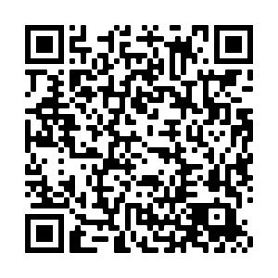
Thank you for attending the Getting Started on Your Assignment workshop today. We would be grateful if you could take 5 minutes to complete our feedback form.
Via the URL here and in the Chat Box
https://forms.office.com/Pages/ResponsePage.aspx?id=lwcinDfD-EmwhqmiSXn3KJx4-QmcBv9NnNg4SAsynGNUMDRJTEhHQ1RYSVVMQVZCNjhBMlpMNExDTi4u
By scanning the QR Code
Notes:
18

Slide 19
The ACE Team
References
Creme, P. and Lea, M. (2008): Writing at university. [3rd edn.] Maidenhead: Open University Press.
Prabhakar, M. (2020): All about OKRs. Available at: https://blogs.talentdux.com/all-about-okrs-c6938cc273d9 (Accessed: 28 October 2021). [Image]

