Slide 1
Mean, Standard Deviation and Variance
The ACE Team

Slide 2
The ACE Team
Overview
What is Mean
Why do we need Standard Deviation and Variance
Interpreting the information from the analysis
Notes:
https://www.investopedia.com/terms/d/descriptive_statistics.asp
https://statistics.laerd.com/statistical-guides/descriptive-inferential-statistics.php
https://study.com/academy/lesson/what-is-descriptive-statistics-examples-lesson-quiz.html

Slide 3
Confidence check
What is your starting point on Descriptive Statistics before the workshop?
Go to slido.com …No need to sign up or log in. Enter the code 02468 and then the passcode tc3uqq in the next screen

Slide 4
The ACE Team
Descriptive Statistics
Measure of Central Tendency
Mean
Measure of Dispersion
Variance
Standard Deviation
Notes:
https://baselinesupport.campuslabs.com/hc/en-us/articles/204305665-Types-of-Descriptive-Statistics

Slide 5
The ACE Team
Descriptive Statistics
Analysis that helps describe the data in a meaningful way. For example, if you have a list of 100 students’ marks, we would like to know what is the range of marks and what is the average mark scored in this group. Descriptive statistics gives you a summary of a pattern emerging from the results your gathered.
Notes:
https://www.investopedia.com/terms/d/descriptive_statistics.asp
https://statistics.laerd.com/statistical-guides/descriptive-inferential-statistics.php
https://study.com/academy/lesson/what-is-descriptive-statistics-examples-lesson-quiz.html

Slide 6
Measure of Central Tendency-Mean
Person | Height in cm
person 1 | 178
person 2 | 178
person 3 | 178
person 4 | 175
person 5 | 179
person 6 | 181
person 7 | 173
person 8 | 183
person 9 | 179
person 10 | 179
person 11 | 177
Notes:
https://study.com/academy/lesson/what-is-descriptive-statistics-examples-lesson-quiz.html

Slide 7
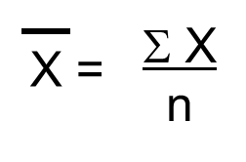
Measure of Central Tendency- formula
Person | Height in cm
person 1 | 178
person 2 | 178
person 3 | 178
person 4 | 175
person 5 | 179
person 6 | 181
person 7 | 173
person 8 | 183
person 9 | 179
person 10 | 179
person 11 | 177
Mean:
Notes:
https://study.com/academy/lesson/what-is-descriptive-statistics-examples-lesson-quiz.html

Slide 8
Measure of Central Tendency
Person | Height in cm
person 1 | 178
person 2 | 178
person 3 | 178
person 4 | 175
person 5 | 179
person 6 | 181
person 7 | 173
person 8 | 183
person 9 | 179
person 10 | 179
person 11 | 177
Notes:
https://study.com/academy/lesson/what-is-descriptive-statistics-examples-lesson-quiz.html

Slide 9
Measure of Central Tendency-Mean
person | Height in cm
person 1 | 175
person 2 | 185
person 3 | 184
person 4 | 180
person 5 | 180
person 6 | 181
person 7 | 174
person 8 | 169
person 9 | 177
person 10 | 184
person 11 | 171
Notes:
https://study.com/academy/lesson/what-is-descriptive-statistics-examples-lesson-quiz.html

Slide 10
Measure of Central Tendency- Calculate the mean using the formula
person | Height in cm
person 1 | 175
person 2 | 185
person 3 | 184
person 4 | 180
person 5 | 180
person 6 | 181
person 7 | 174
person 8 | 169
person 9 | 177
person 10 | 184
person 11 | 171
Mean:
Notes:
https://study.com/academy/lesson/what-is-descriptive-statistics-examples-lesson-quiz.html

Slide 11
Measure of Central Tendency- Calculate the mean using the formula
person | Height in cm
person 1 | 175
person 2 | 185
person 3 | 184
person 4 | 180
person 5 | 180
person 6 | 181
person 7 | 174
person 8 | 169
person 9 | 177
person 10 | 184
person 11 | 171
Notes:
https://study.com/academy/lesson/what-is-descriptive-statistics-examples-lesson-quiz.html

Slide 12
The ACE Team
How can we interpret the data in this situation?
Two different sets of data
Same mean
Notes:
https://www.investopedia.com/terms/d/descriptive_statistics.asp
https://statistics.laerd.com/statistical-guides/descriptive-inferential-statistics.php
https://study.com/academy/lesson/what-is-descriptive-statistics-examples-lesson-quiz.html

Slide 13
The ACE Team
How can we interpret the data in this situation?
Two different sets of data
Same mean
We need Measure of Dispersion
Notes:
https://www.investopedia.com/terms/d/descriptive_statistics.asp
https://statistics.laerd.com/statistical-guides/descriptive-inferential-statistics.php
https://study.com/academy/lesson/what-is-descriptive-statistics-examples-lesson-quiz.html

Slide 14
Formulae
Mean – Central Tendency
Variance- Measure of Dispersion
Variance $s^{2}=\frac{{Σ\left(x−\overline{x}\right)}^{2}}{n−1}$
Standard Deviation $s=\sqrt{\frac{{Σ\left(x−\overline{x}\right)}^{2}}{n−1}}$

Slide 15
The ACE Team
Measure of Dispersion: Variance
Variance tells us how far, on average, each value is from the mean.
To find this, first find the difference of each item from the mean, then find the average (Sum and divide)
$$s^{2}=\frac{{Σ\left(x−\overline{x}\right)}^{2}}{n−1}$$
Notes:
https://www.investopedia.com/ask/answers/021215/what-difference-between-standard-deviation-and-variance.asp

Slide 16
The ACE Team
Measure of Dispersion: Standard Deviation and Variance
Variance tells us how far, on average, each value is from the mean $s^{2}=\frac{{Σ\left(x−\overline{x}\right)}^{2}}{n−1}$
Standard Deviation tells us how spread the data is either side of mean. It shows what the “average range” is, and which values might be outside a typical average range.
$s=\sqrt{\frac{{Σ\left(x−\overline{x}\right)}^{2}}{n−1}}$
The greater the variance and standard deviation, the wider the data is spread
Notes:
https://www.investopedia.com/ask/answers/021215/what-difference-between-standard-deviation-and-variance.asp

Slide 17
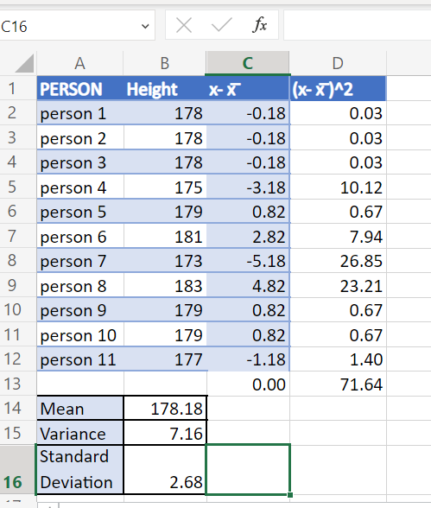
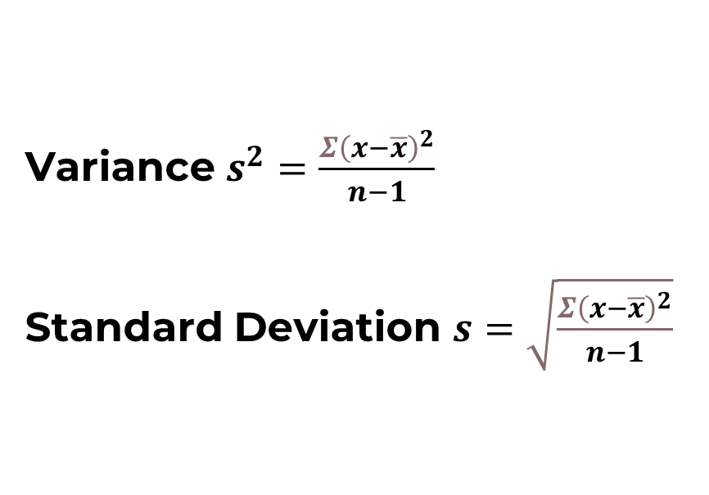
Variance $s^{2}=\frac{{Σ\left(x−\overline{x}\right)}^{2}}{n−1}$
Standard Deviation $s=\sqrt{\frac{{Σ\left(x−\overline{x}\right)}^{2}}{n−1}}$

Slide 18
Let’s calculate the standard deviation and the variance
https://www.mathsisfun.com/data/standard-deviation-calculator.html
Or use =STDEV.S formula in Excel.
The Netherlands |  | The UK
Mean | SD | Mean | SD
178.18 | 2.68 cm (dispersion is between 178.18-2.68 and 178.18+2.68) | 178.18 | 5.42 (dispersion of data is between 178.18-5.42 and 178.18+5.42)

Slide 19
Comparison of the Standard Deviation between two sets of data
Suppose, a retailer is to order shipment for different sizes of trousers to both countries. How would they interpret this data and what conclusion could they make?

Slide 20
How can you apply this knowledge to other scenarios
A mean test score in Accounting module is 72%with an SD of 10
A mean test score in Economics module is 65% with an SD of 5
Which is better?
Average return on investment (profit) for company A is 1.68% with a SD of 3.8%
Average return on investment (profit) with company B is 5% with a SD of 6%
Which is better?

Slide 21
The ACE Team
Explore further
To understand more about Mean, Median, Mode and Standard Deviation, watch https://youtu.be/mk8tOD0t8M0
To understand more about grouped frequency data, see https://www.mathsisfun.com/data/frequency-grouped-mean-median-mode.html
See more on basic statistics here https://www.mathsisfun.com/data/#stats
The difference between variance and standard deviation https://www.investopedia.com/ask/answers/021215/what-difference-between-standard-deviation-and-variance.asp

Slide 22
Confidence check
What is your starting point on Descriptive Statistics before the workshop?
Go to slido.com …No need to sign up or log in. Enter the code 02468 and then the passcode tc3uqq in the next screen

Slide 23
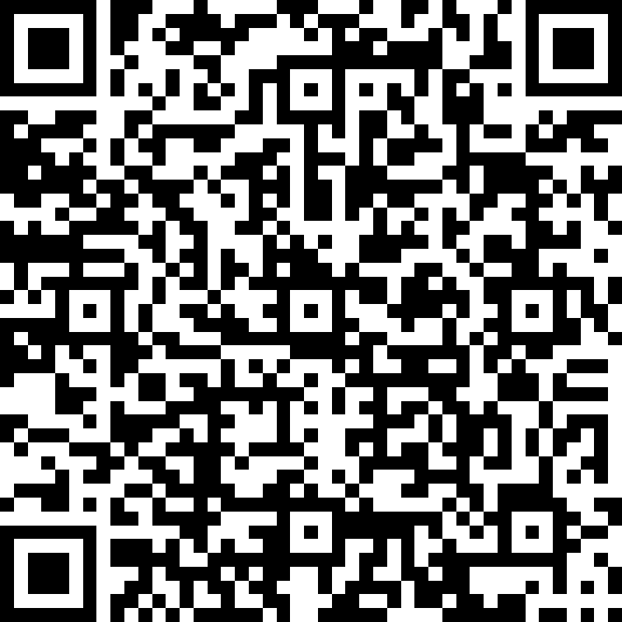
The ACE Team
Feedback
https://forms.office.com/r/vgG8QgxeaD

