Slide 1



Python for Beginners
The ACE Team

Slide 2


The ACE Team
Python - Introduction
* It is simple to learn and use
* It can be used for rapid prototyping
* It is quite powerful despite its simplicity
* It is open source and effectively free to develop
Python is an object-oriented programming language created by Guido Rossum in 1989.
It is one of the popular programming languages in the world for several reasons:

Slide 3
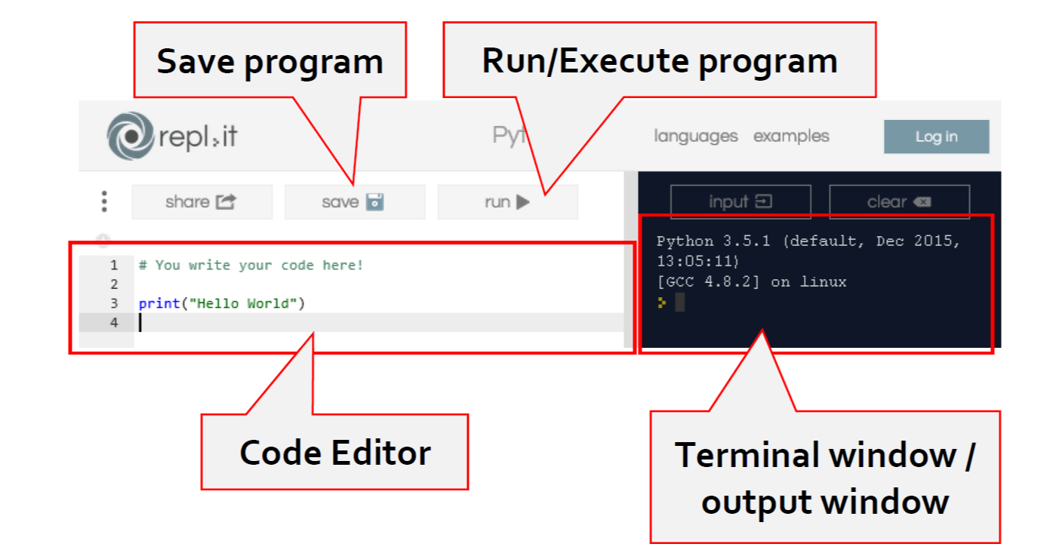

The ACE Team
Repl.it
https://replit.com/ I have used free online IDE called repl.it to program and test my code
www.simonhaughton.com
Notes:
www.simonhaughton.com

Slide 4
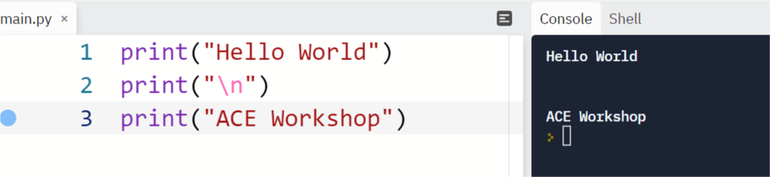
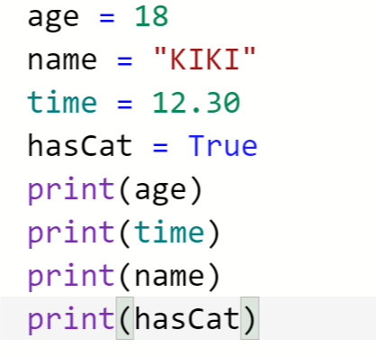
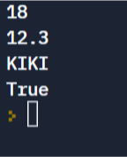
The ACE Team
Printing text and creating variables
variables
A variable is a point in the computer’s memory that we assign to hold data for later use in the program

Slide 5
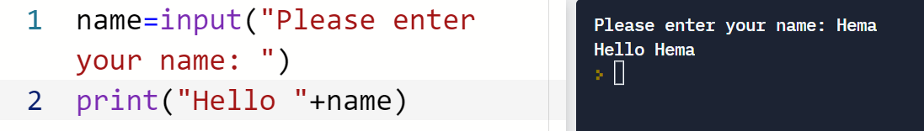
The ACE Team
Reading Keyboard Input
In Python input() function is used to get some input from the user

Slide 6
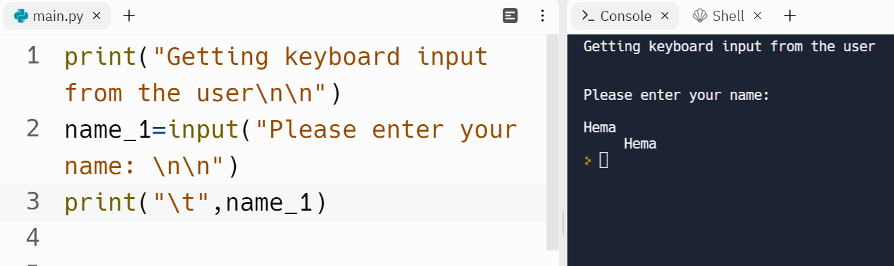
The ACE Team
Reading Keyboard Input
What does the escape sequence \n and \t do?

Slide 7

The ACE Team
Basic Data Types:
Data Type Operator Description
String str Text or numbers that can be concatenated
Integer int Whole number with no decimal part
Float float Number with a decimal part
Boolean bool True or False
What are the other data types in python? Check out:
https://www.w3schools.com/python/python_datatypes.asp

Slide 8
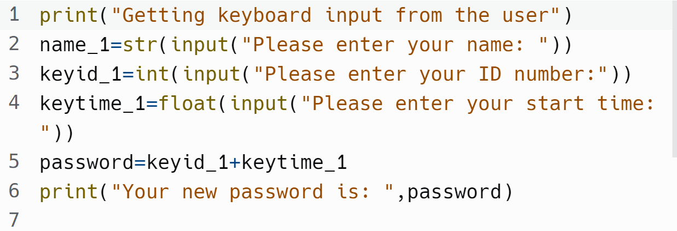
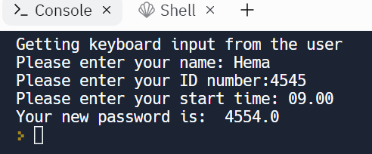
The ACE Team
Reading Keyboard Input
Try the same code without str, int and float – What do you see? What is your final answer?

Slide 9
Operators in Python
Arithmetic operators
Assignment operators
Comparison operators Check out:
Logical operators
Identity operators
Membership operators
Bitwise operators
https://www.w3schools.com/python/python_operators.asp

Slide 10
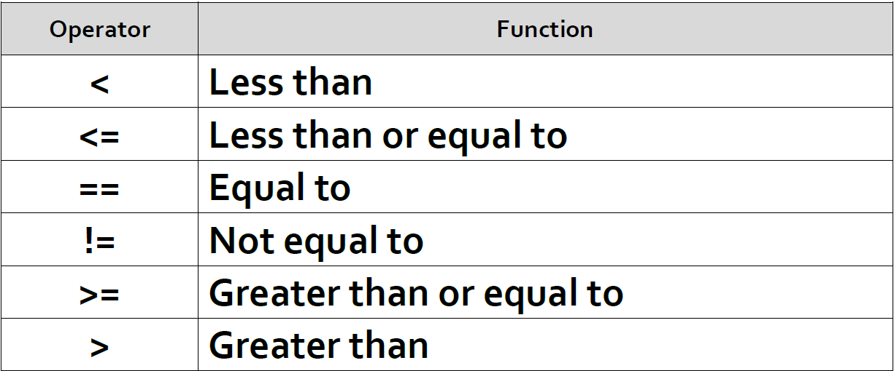

The ACE Team
Commonly used operators in programming
https://open.ed.ac.uk/5861-2/
Notes:
https://open.ed.ac.uk/5861-2/

Slide 11
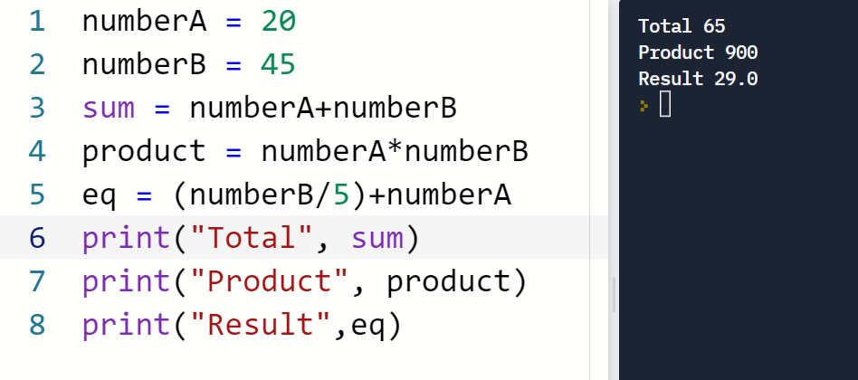
The ACE Team
Calculations

Slide 12
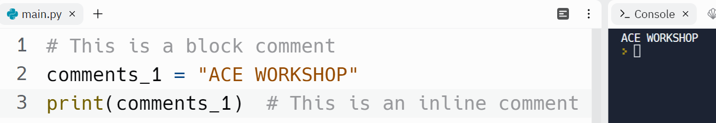
The ACE Team
Comments
When executing a program, the Python interpreter ignores the comments and only interprets the code
Block Comment: is added as a new line
Inline Comment: is added on the same line as the code referenced
Notes:
https://www.w3schools.com/python/python_comments.asp
phrase = "Hello, World" # This comment is PEP 8 compliant.
print(phrase)# This comment isn't.
For inline comments, PEP 8 recommends at least two spaces between the code and the # symbol:

Slide 13
Strings, Lists, Tuples, Sets & Dictionaries

Slide 14
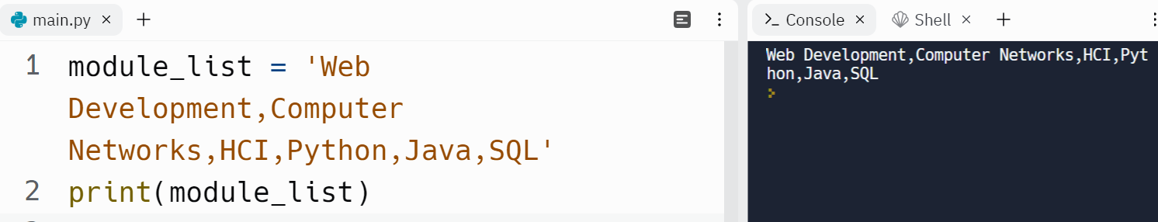
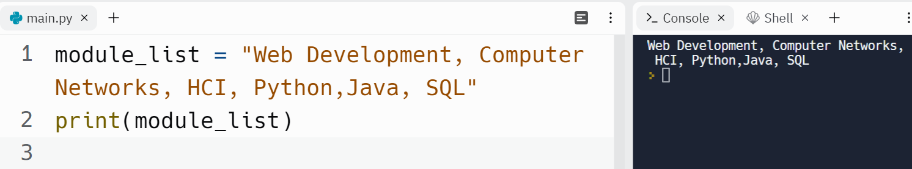
The ACE Team
Strings
Collection of text are called STRINGS in Python. To manipulate strings, special functions called string methods are used.
Either single quotes or double quotes can be used to create a string

Slide 15

The ACE Team
Try this:
What does [:3] do?
What does + do?
What would [3] do?
Notes:
https://www.w3schools.com/python/

Slide 16
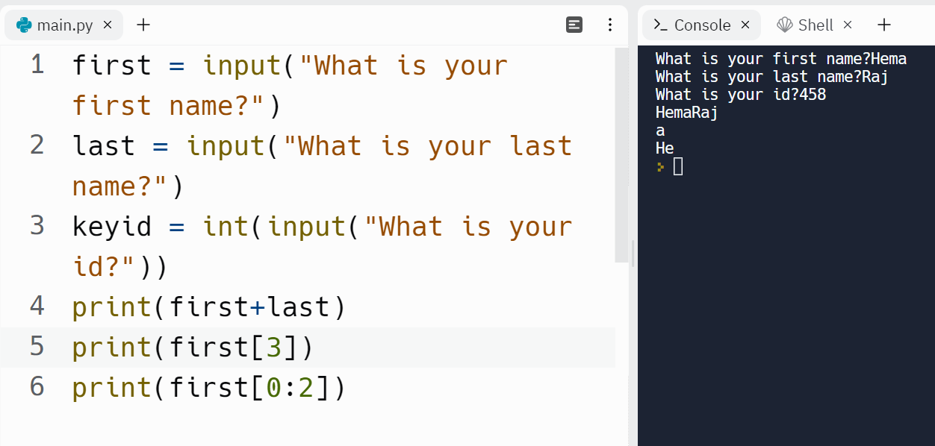
The ACE Team
and this:
Concatenation
Indexing
Slicing
Concatenation
Indexing
Slicing
Try out: print(first,last)?
Notes:
https://www.w3schools.com/python/

Slide 17



The ACE Team
String Operations:
Concatenation - joins two strings together (Refer to the code in the
previous page)
Indexing - gets a single character from a string
Slicing - gets several characters from a string at once
Notes:
https://www.w3schools.com/python/

Slide 18
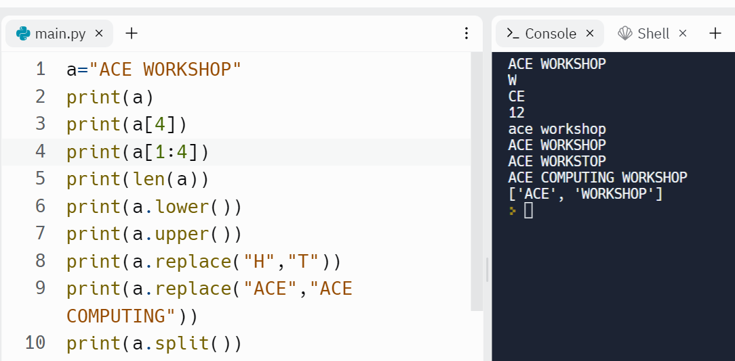
The ACE Team
String Methods

Slide 19
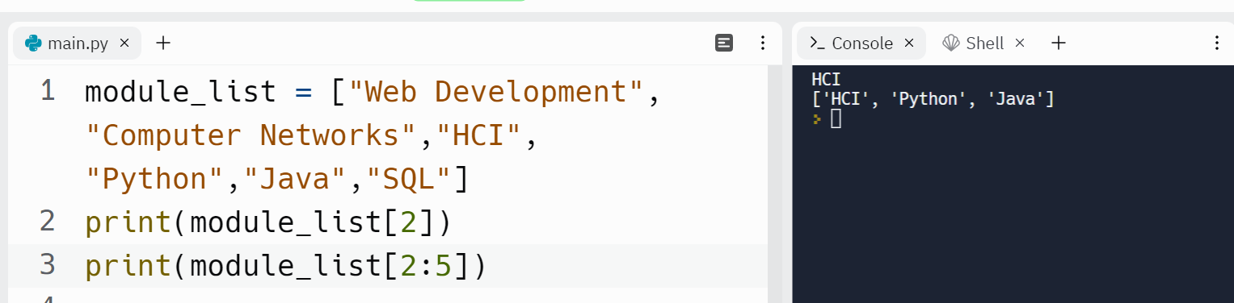
The ACE Team
Python Collections (Arrays): Lists, Tuples, Sets,& Dictionaries
Lists: collection which is ordered and changeable.
Can be duplicated.

Slide 20
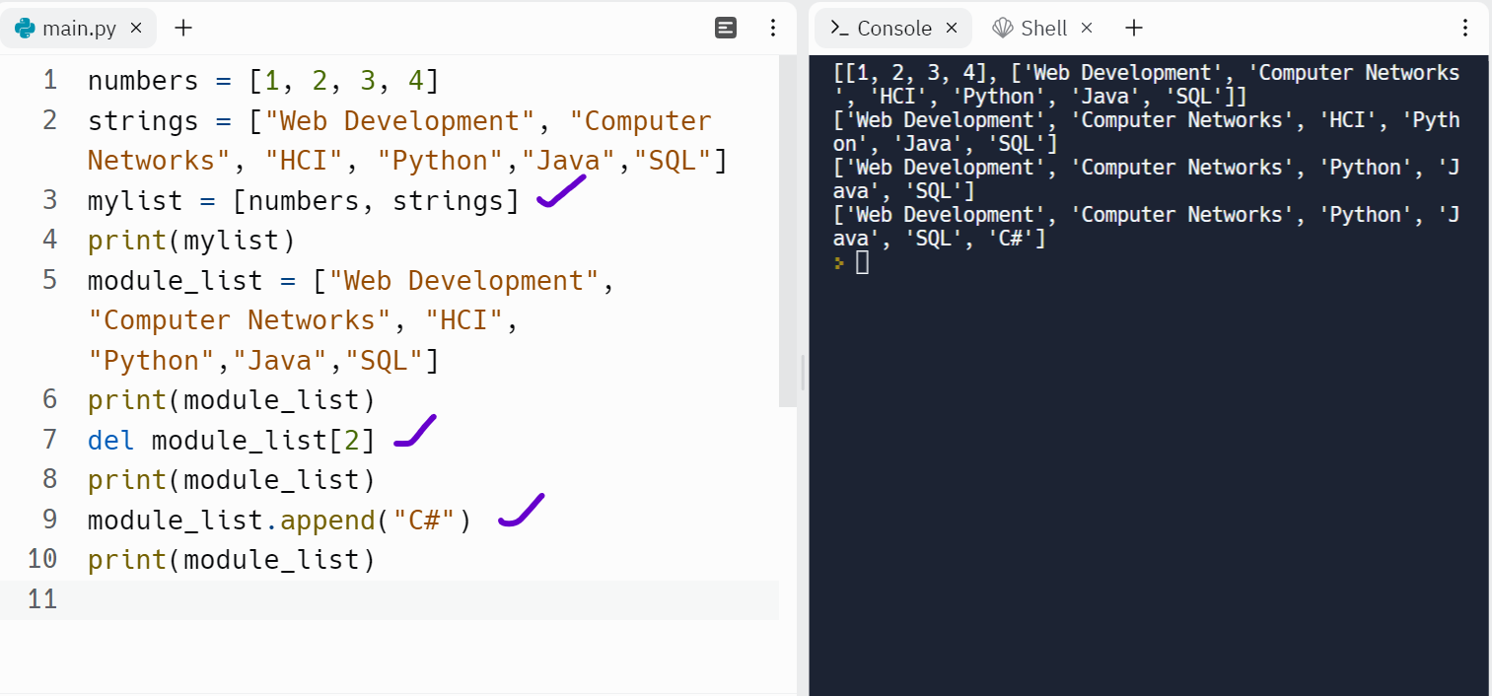
The ACE Team

Slide 21
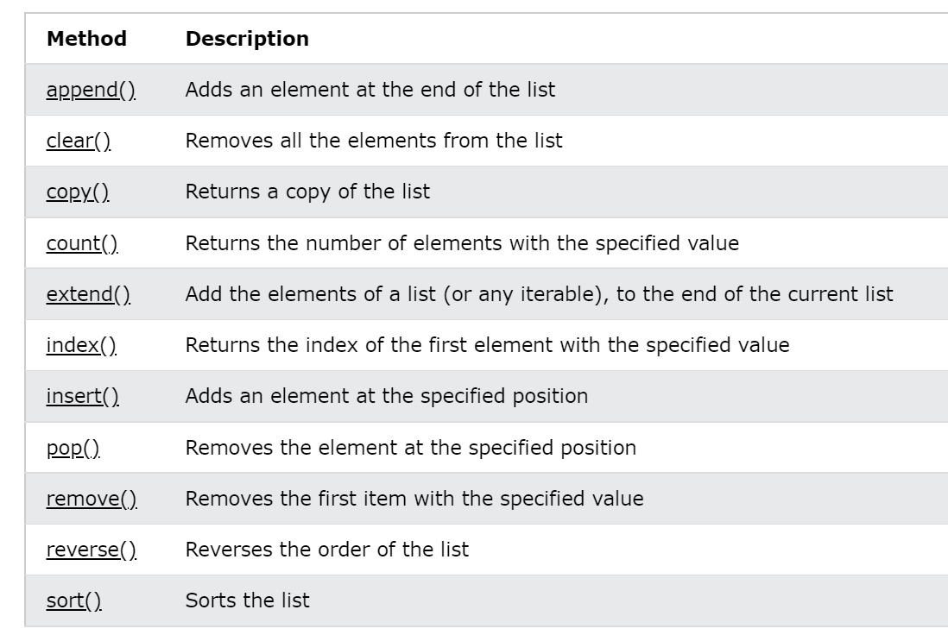
The ACE Team
Built-in methods that can be used on lists

Slide 22
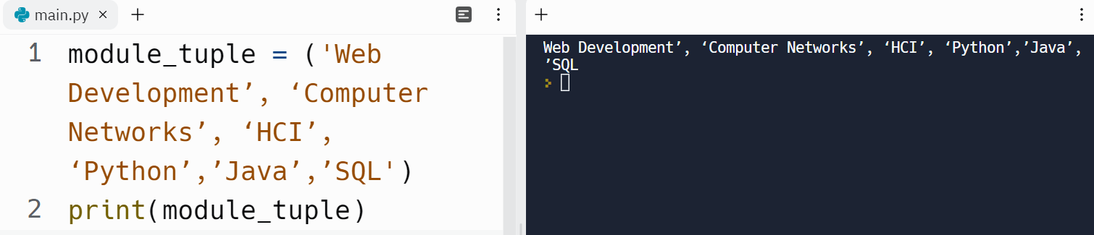
The ACE Team
Tuples : collection which is ordered and unchangeable.
Can be duplicated.

Slide 23
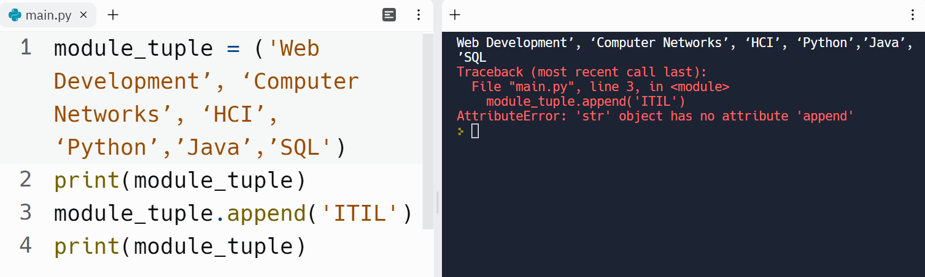
The ACE Team
Tuples:
Why do we have an error, here?

Slide 24
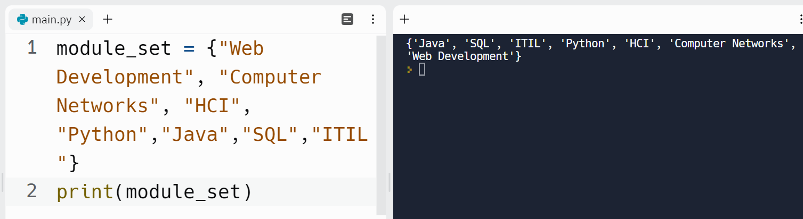
The ACE Team
Sets: collection which is unordered, unchangeable, and unindexed
Cannot be duplicated.

Slide 25
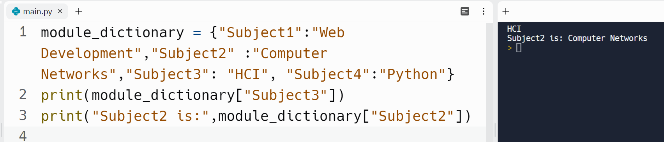
The ACE Team
Dictionaries: collection which is ordered and changeable
Cannot be duplicated.

Slide 26
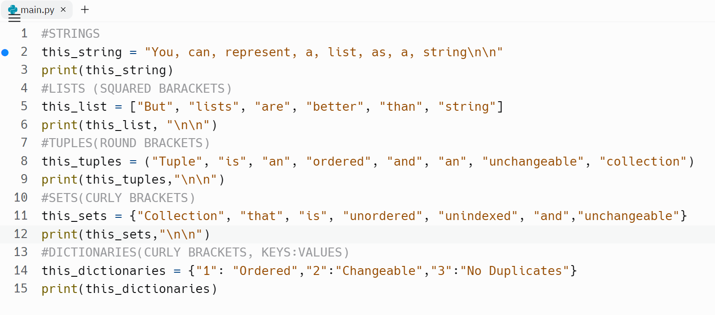
The ACE Team
Try this:
Strings are inside “ ” or ’ ’
Lists has a squared bracket [ ]
Tuples has a round brackets ( )
Sets has a curly brackets { }
Dictionaries has {keys: values}

Slide 27
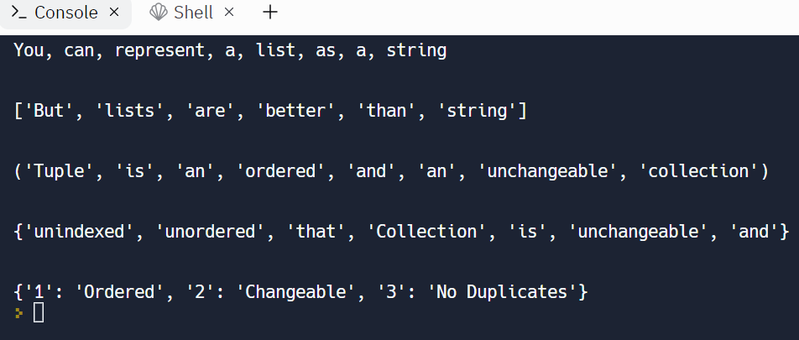
The ACE Team
Output:

Slide 28
Comparisons and Iterations

Slide 29
The ACE Team
Comparison (if and else)

Slide 30
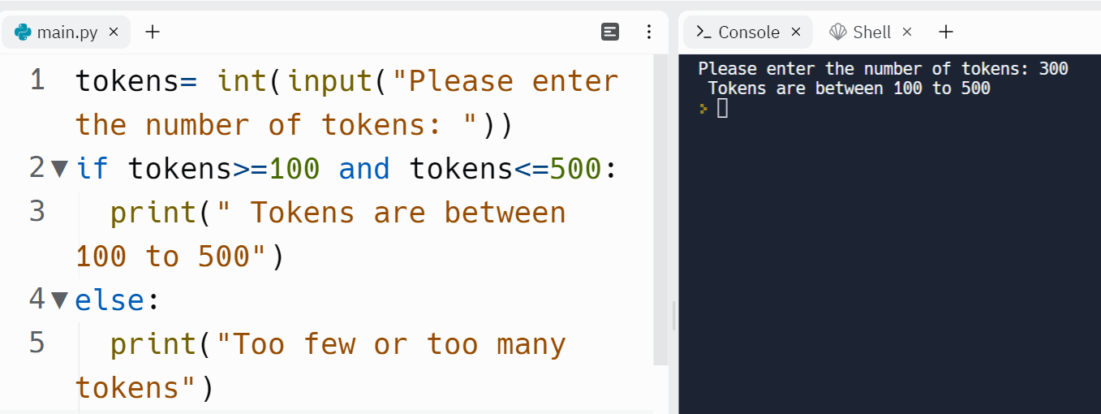
The ACE Team
What does and do ?

Slide 31
The ACE Team
Iteration : for loop
We KNOW how many times the loop must repeat - FOR loop.
Notes:
https://open.ed.ac.uk/5861-2/

Slide 32
The ACE Team
Iteration : while loop
There will be times in Computing when we want to use a loop, but we are unsure how many times to repeat.
We DO NOT KNOW how many times the loop must repeat - WHILE loop.
Notes:
https://www.w3schools.com/python

Slide 33
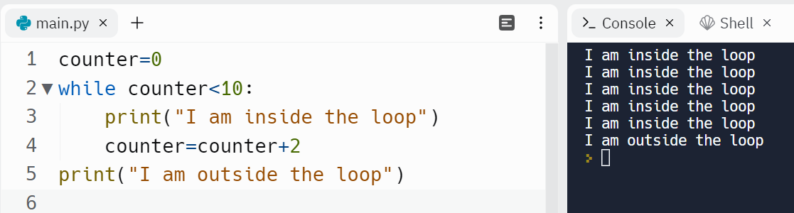
The ACE Team
Using counters
Why and when would you use counters?
Try counter=counter -1
https://open.ed.ac.uk/5861-2/

Slide 34
Functions
Built-in Functions and Libraries

Slide 35
The ACE Team
Built-in functions and libraries
Python consists of many built-in functions. The print() function is one such built-in function that we have used a lot in this workshop.
Python also consists of different modules, libraries and packages that has a lot of predefined functions for different topics such as mathematics, science, database systems, plots etc.
Top libraries for maths:
1. Math
2. Numpy
3. SciPy
4. Statsmodel
Top data visualization libraries:
1. Matplotlib
2. Plotly
3. ggplot
4. Pygal
https://www.w3schools.com/python/module_math.asp

Slide 36
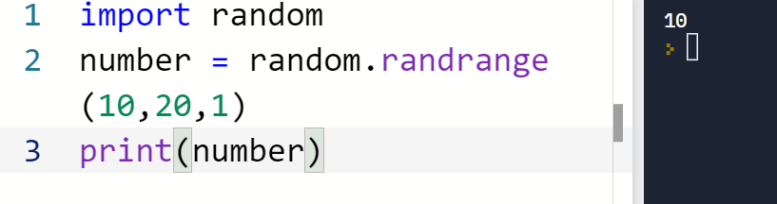
The ACE Team
Calculations and Random Numbers
Actions like getting a random number, selecting a random element from a list, random shuffling can be done by importing a random module into your code.
Generates a randomly selected element from range (start, stop, step)
https://www.w3schools.com/python

Slide 37
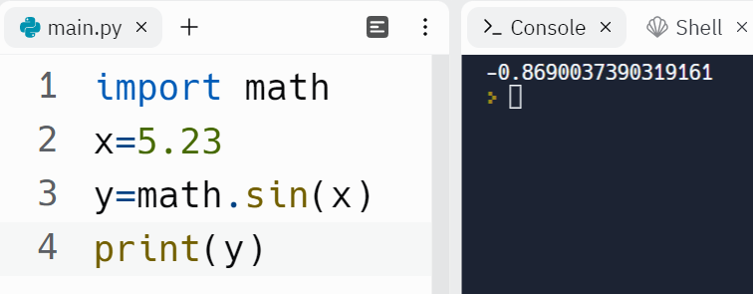
The ACE Team
The math module has all the basic math functions such as trigonometric functions, logarithmic functions, angle conversion functions and constants like pi, e (Euler’s number) etc.
Try this out
https://www.w3schools.com/python/module_math.asp

Slide 38
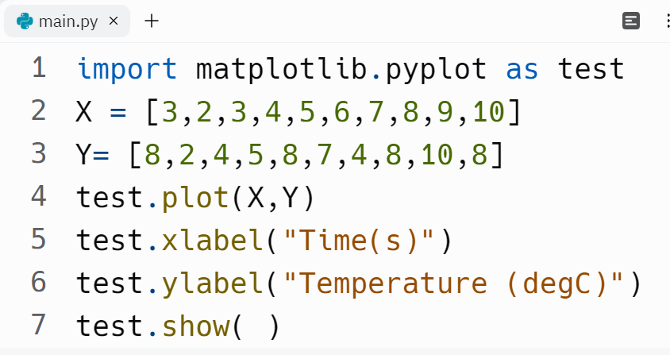
The ACE Team
Plots using Python
Try this out

Slide 39
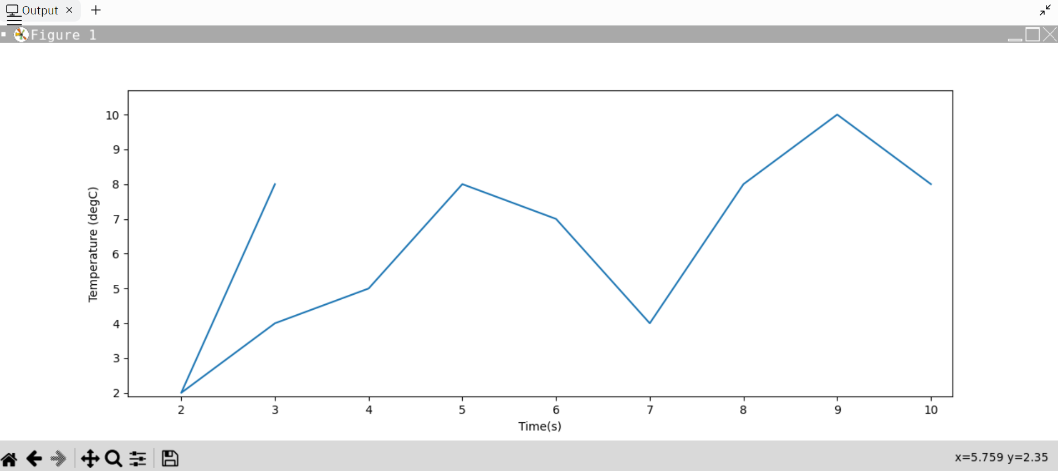
The ACE Team
Output for the code in the previous page:
Do you see the same in your screen?

Slide 40
User defined functions

Slide 41
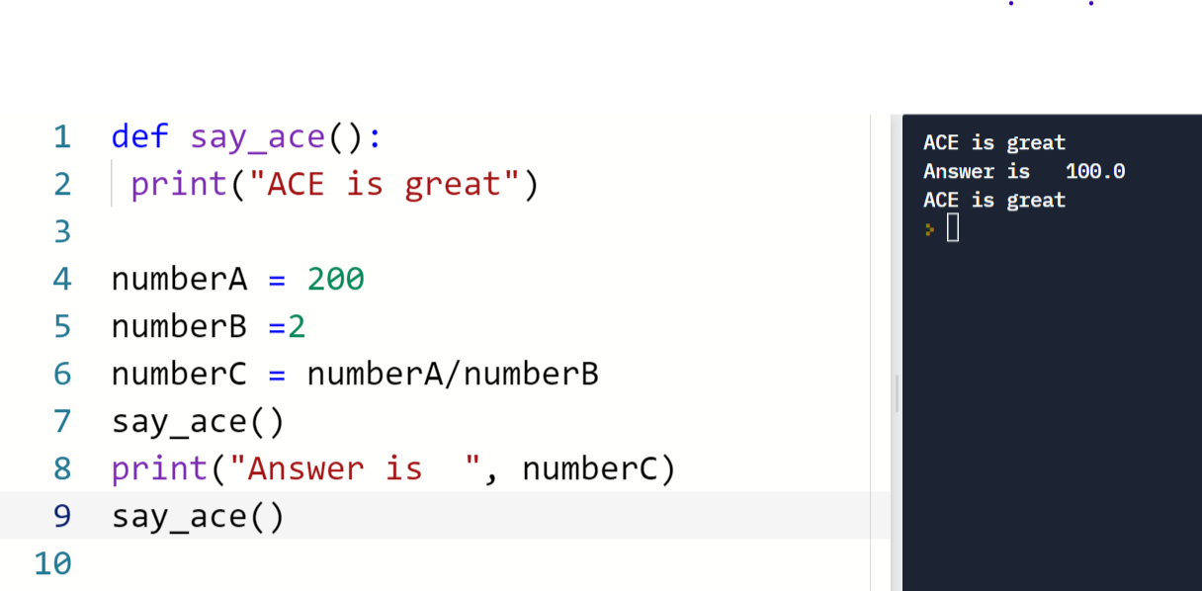
The ACE Team
Functions/ Subroutines
A subroutine gives a single name to a set of actions.
You create a subroutine by defining it.
You can use the subroutine at any time in your program by calling it.
1.Define the subroutine and give it a name.
3.Call the subroutine whenever you need it by typing its name.
2. Add the code that you need to complete the task
Notes:
https://www.w3schools.com/python

Slide 42
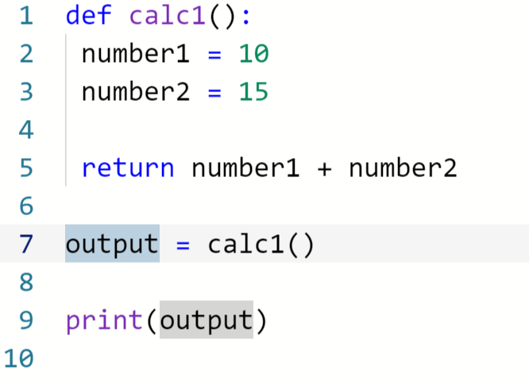
The ACE Team
Function that returns a value
A function can return some data back to the main program.
When you do this, you should store the returned value in a variable in the main program

Slide 43
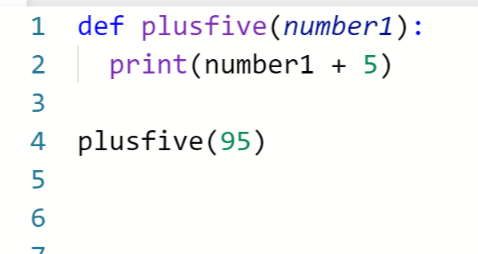
The ACE Team
Function with arguments
We can put data into a function. To do this we use arguments.
You can think of arguments like variables used by the function.
Notes:
https://www.w3schools.com/python

Slide 44
Object Oriented Programming in Python

Slide 45
Object Oriented Programming in Python
Object Oriented Programming(OOP) is a style of programming used to create a neat and reusable code by bundling related properties and behaviours into individual objects.
OOP is an approach for modelling concrete, real-world things, like cars, as well as relations between things, like companies and employees, students and teachers, and so on. OOP models real-world entities as software objects that have some data associated with them and can perform certain functions.
Another common programming paradigm is procedural programming, which structures a program like a recipe in that it provides a set of steps, in the form of functions and code blocks, that flow sequentially in order to complete a task.
https://realpython.com/

Slide 46
OOP(Object Oriented) and POP(Procedural Oriented)
Difference between Object Oriented Programming and the
Procedural Oriented Programming
Object Oriented Programming | Procedural Oriented Programming
It is a bottom up approach | It is a top down approach
Makes use of access modifiers ‘public’, private’, protected’ | Doesn’t use access modifiers
Program is divided in objects | Program is divided into functions
Supports Inheritance | Doesn’t support Inheritance

Slide 47
Classes and Objects:
Classes and objects are the two main features of OOP.
A class is a collection of objects, or it can be said it is a blueprint of objects with methods and attributes whereas objects are instances of the class.
**In Python, everything is an object. Strings, integers, lists, and even functions are individual objects.

Slide 48

The ACE Team
Classes and Objects:
PEN
Class
Object
Brand: Parker
Attributes
Colour: Silver
write()
draw()
Methods

Slide 49
The ACE Team
Attributes and Methods
Things that describe an object – Attributes
pen.brand
pen.colour
To assign a value : pen.brand=“Parker”
To display the value : print(pen.brand)
Things you can to do an object – Methods
Methods determines the functionality of the class
The pen object can have these methods
pen.write()
pen.draw()
Instances are objects that are created which follow the definition given inside of the class

Slide 50
The ACE Team
Classes
Built-in Classes
User-defined Classes

Slide 51
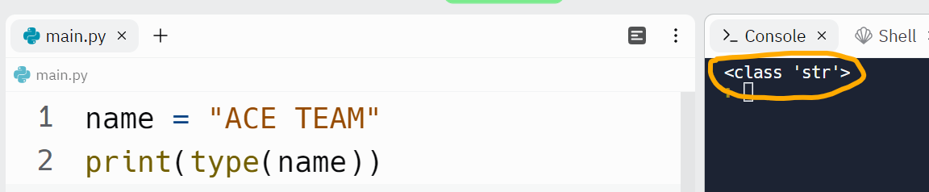
The ACE Team
Built-in Classes
In the below example we have created an object name which belongs to an inbuilt class str . Remember, everything in Python is an object which belongs to a class.
Object which belongs to the class str
Object which belongs to the class str
String is a built in class. So are int, float, tuple, lists, dictionaries etc

Slide 52
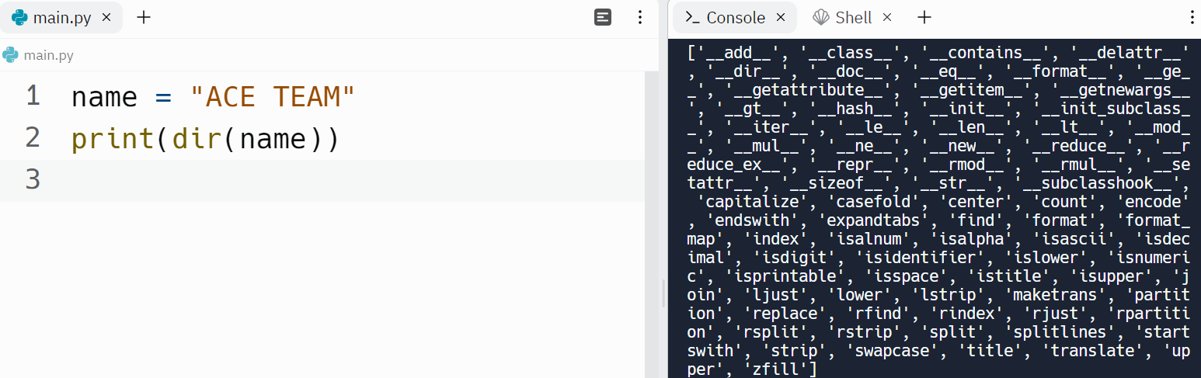
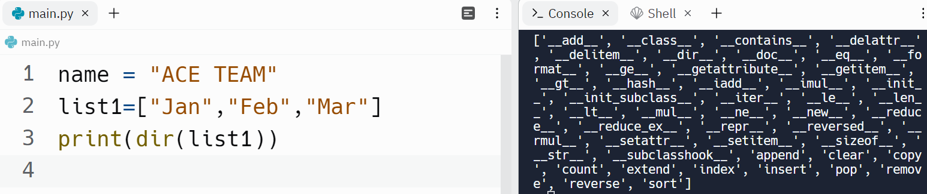
The ACE Team
Every class has its own methods as shown in the below examples
dir displays all the built in Methods

Slide 53
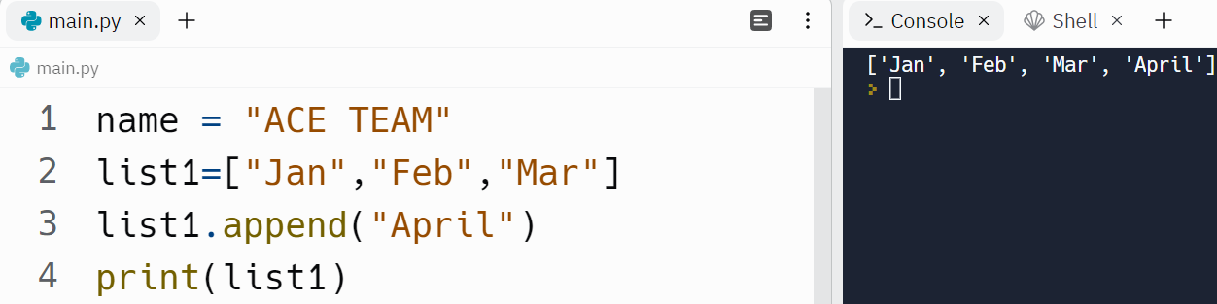
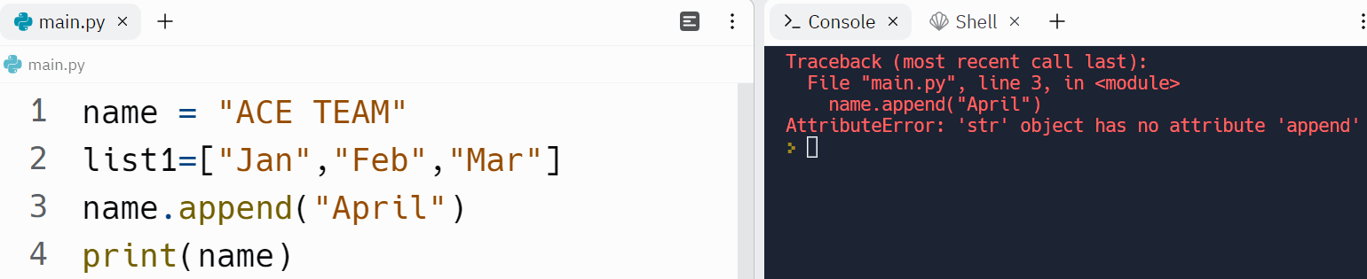
The ACE Team
Try calling a method from a different class and see what happens?
append is a method in list class
name belongs to a different class(str) which does not have append method

Slide 54
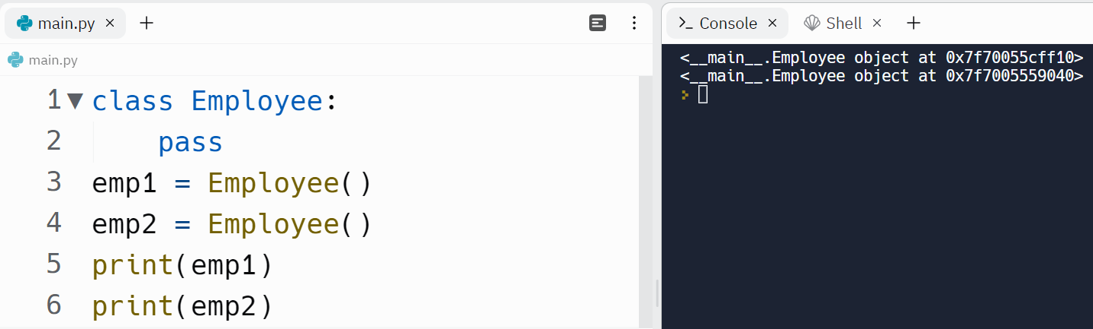
The ACE Team
User defined Classes
To create a class, class keyword is used
pass indicates that the class is empty.
emp1 and emp2 in the above examples are objects inside the class Employee
Check what happens when you print emp1 and emp2?

Slide 55
The ACE Team
User defined Classes
Objects emp1 and emp2 are
stored in an unique memory
address

Slide 56
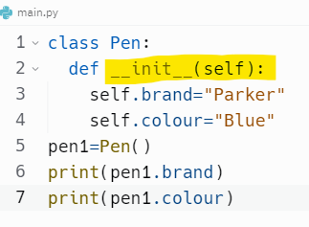
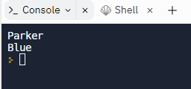
The ACE Team
__init__( ) method
Constructor of the class
The __init__ method is a special method that initializes an individual object.
This method runs automatically each time an object of a class is created.
The first parameter inside the __init__should be self .
It refers to the individual object itself.
Notes:
https://www.w3schools.com/python
realpython

Slide 57
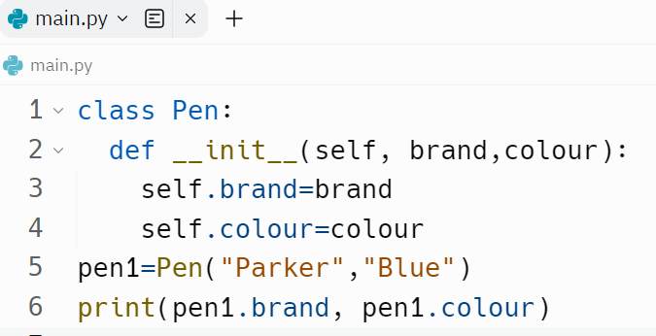
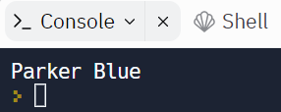
The ACE Team
Note: def is similar to functions but with self. It makes the __init__ a method with self in it.

Slide 58
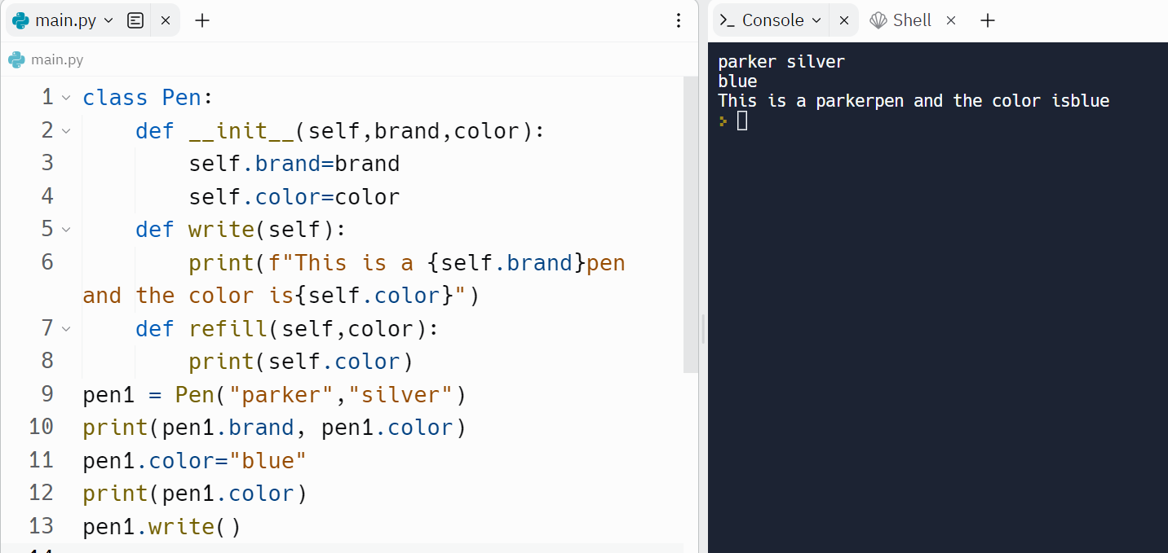
The ACE Team
Try this code out. What do you see?

Slide 59
The ACE Team
Object Oriented Programming Methodologies
Inheritance
Polymorphism
Encapsulation
Abstraction
Notes:
https://www.w3schools.com/python
realpython

Slide 60
The ACE Team
Inheritance
Inheritance is the procedure in which one class inherits the attributes and methods of another class.
Types of Inheritance
Single
Inheritance
Multilevel
Inheritance
Hierarchical Inheritance
Multiple Inheritance

Slide 61
The ACE Team
Single Inheritance
Inheriting or transferring all the methods and properties from another class is called as single inheritance
Class being inherited from - Parent class/base class
Class that inherits from another class - Child class/ derived class

Slide 62
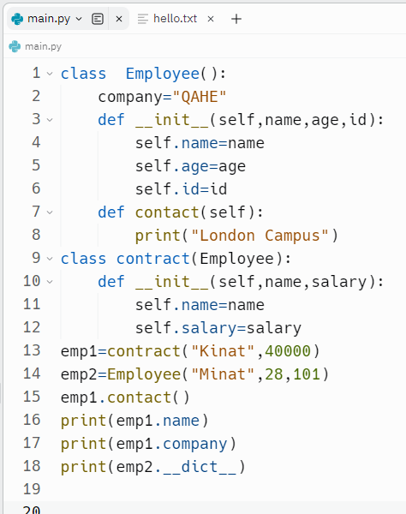
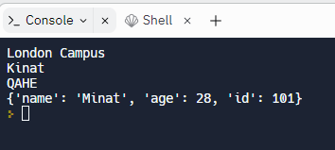
The ACE Team
Try out this sample to understand single inheritance
Employee() is the parent class here and the contract is the child class.
Notes:
https://www.w3schools.com/python
realpython

Slide 63
The ACE Team
Multilevel Inheritance
Type of Inheritance in which a class inherits from another class, which in turn inherits from another class.
Try the code in the next slide to understand about multilevel inheritance
Notes:
https://www.w3schools.com/python
realpython

Slide 64
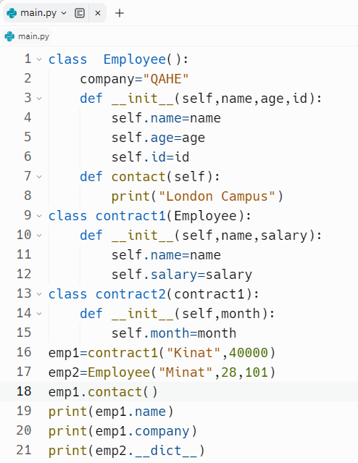
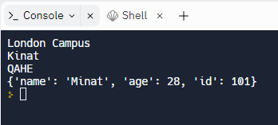
The ACE Team
Notes:
https://www.w3schools.com/python
realpython

Slide 65
The ACE Team
File Handling

Slide 66
The ACE Team
File Handling
Files are used to permanently store data in a non-volatile memory like hard disk.
In Python, a file operation takes place in the following order:
Open a file
Read or write (perform an operation)
Close the file
Notes:
https://www.w3schools.com/python
Realpython
Random Access Memory (RAM) is volatile (which loses its data when the computer is turned off)

Slide 67
The ACE Team
Types of File in Python
Text Files:
contents are stored as bytes and is represented as ASCII values
of characters.
It can be understood as a sequence of characters consisting of
alphabets, numbers and special symbols.
Examples:
Web standards: html, XML, CSS, JSON etc.
Source code: c, js, py, java etc.
Documents: txt, tex, RTF etc.
Tabular data: csv, tsv etc.
Configuration: ini, cfg, reg etc.
Notes:
https://www.w3schools.com/python
Realpython
Random Access Memory (RAM) is volatile (which loses its data when the computer is turned off)

Slide 68
The ACE Team
Types of File in Python
Binary Files:
Also stored as bytes(0s,1s) but contents inside the binary files cannot be read as they don’t represent the ASCII values of characters.
Examples:
Document files: .pdf, .doc, .xls etc.
Image files: .png, .jpg, .gif, .bmp etc.
Video files: .mp4,.avi etc.
Audio files: .mp3, .wav etc.
Database files: .mdb,.sqlite etc.
Archive files: .zip, .rar etc.
Executable files: .exe, .class etc
Notes:
https://www.w3schools.com/python
Realpython
Random Access Memory (RAM) is volatile (which loses its data when the computer is turned off)

Slide 69
The ACE Team
Opening a File
The most important function for working with files is open().
2 parameters as arguments - file name and the access mode
file1 =open(“hello.txt”,”r”)
Modes:
“r “- opens the file in read-only mode(Default value).
“w” - opens the file in write-only mode.
“a” - opens the file in appending mode.
“x” - creates the specified file(throws an error if the file exists)
“r+” - this mode opens the file in reading and writing mode.
Notes:
https://www.w3schools.com/python
Realpython
Random Access Memory (RAM) is volatile (which loses its data when the computer is turned off)

Slide 70
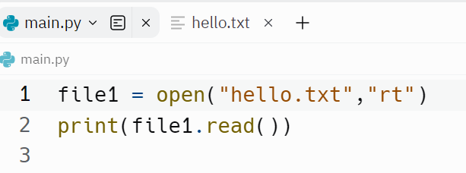
The ACE Team
Opening a File
In addition to this, binary or text mode can also be specified.
“t” – Text
“b”– Binary
Notes:
https://www.w3schools.com/python
Realpython
Random Access Memory (RAM) is volatile (which loses its data when the computer is turned off)

Slide 71
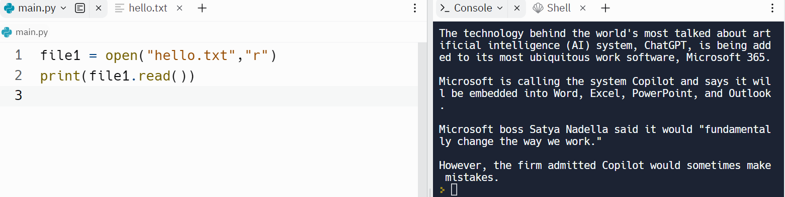
The ACE Team
Opening a file
The open() function has a read() method for reading the content of the text file.
Notes:
https://www.w3schools.com/python
Realpython
Random Access Memory (RAM) is volatile (which loses its data when the computer is turned off)

Slide 72
The ACE Team
Reading a File
file1 = open(“c:\\test\hello.txt", "r") (its important to give the right file location)
print(file1.read())
Notes:
https://www.w3schools.com/python
Realpython
Random Access Memory (RAM) is volatile (which loses its data when the computer is turned off)

Slide 73


The ACE Team
Reading a File
Number of characters to be returned can also be specified.
print(file1.read(50))
One line can be returned by using readline() method : print(file1.readline())
Notes:
https://www.w3schools.com/python
Realpython
Random Access Memory (RAM) is volatile (which loses its data when the computer is turned off)

Slide 74


The ACE Team
Reading a File
Try this one.
Notes:
https://www.w3schools.com/python
Realpython
Random Access Memory (RAM) is volatile (which loses its data when the computer is turned off)

Slide 75


The ACE Team
Creating a new file and writing on it
Creating a new
file ACE.txt
Look at the files here
Notes:
https://www.w3schools.com/python
Realpython
Random Access Memory (RAM) is volatile (which loses its data when the computer is turned off)

Slide 76
The ACE Team
Deleting file and folders
Deleting Files:
import os
os.remove("demofile.txt")
Deleting Folders:
import os
os.rmdir("myfolder")
** Make sure to delete all the files inside the
folder before deleting the folder itself.
Notes:
https://www.w3schools.com/python
Realpython
Random Access Memory (RAM) is volatile (which loses its data when the computer is turned off)

Slide 77
The ACE Team
Deleting Folders:
import os
os.rmdir("myfolder")
** Make sure to delete all the files inside the
folder before deleting the folder itself.
Notes:
https://www.w3schools.com/python
Realpython
Random Access Memory (RAM) is volatile (which loses its data when the computer is turned off)

Slide 78

The ACE Team
More to come…
hemalatha.raj@qa.com
Notes:
https://www.w3schools.com/python
Realpython
Random Access Memory (RAM) is volatile (which loses its data when the computer is turned off)

Slide 79

The ACE Team
Thank You!
Notes:
https://www.w3schools.com/python

