Slide 1
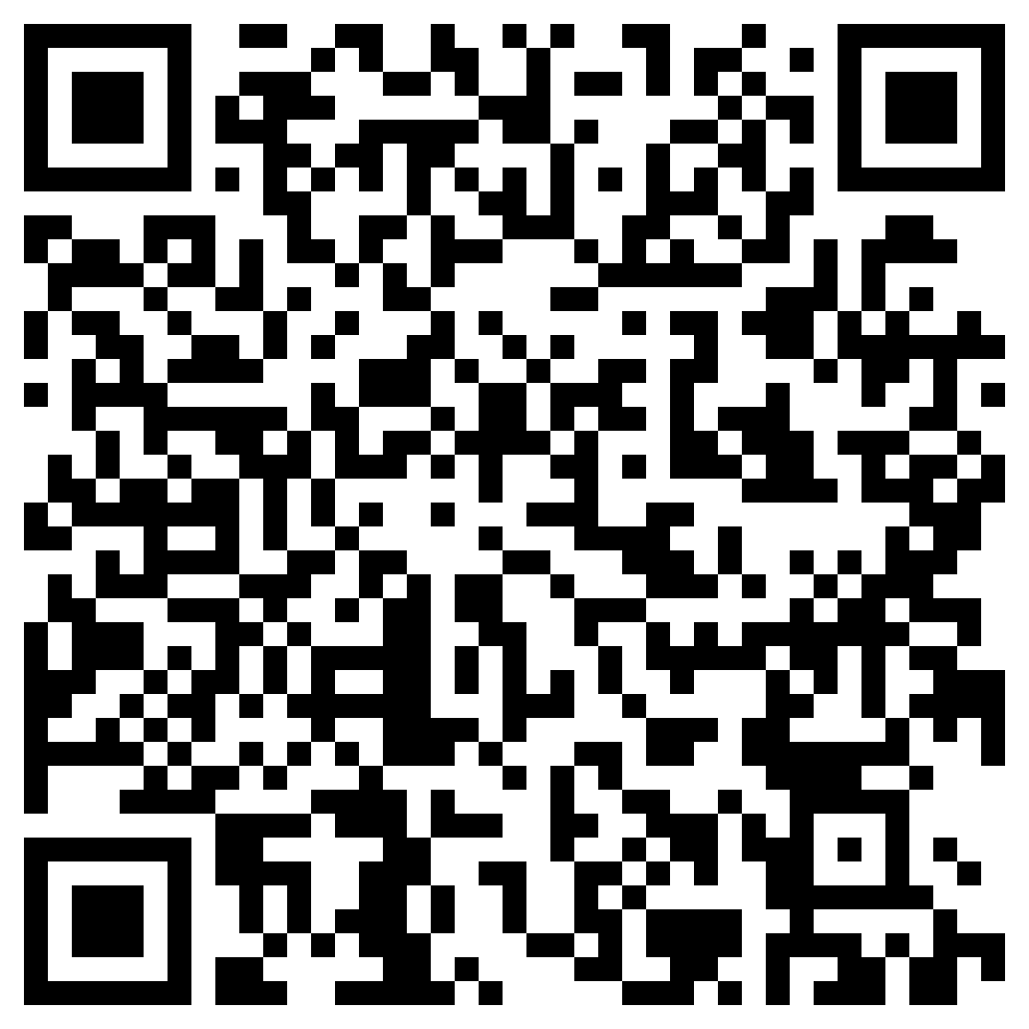
Academic Reading Club Session 1
The ACE Team
The session will start at ...
Please ensure that your speaker/output settings are correct.
Please ensure that you register for this workshop here:
Study Skills Workshop Attendance Form (office.com)
Notes:
https://elp.northumbria.ac.uk/ultra/organizations/_783464_1/outline

Slide 2
Icebreaker:
Do you prefer printed books or online/ digital reading?
If you prefer reading printed texts, use the ‘heart’ reaction:
If you prefer online reading, use the ‘fire’ reaction:
Now tell us why or why not?

Slide 3
The ACE Team
Topics covered in the Academic Reading Club
Strategies for more efficient reading
Reading critically
Listening, writing and speaking skills

Slide 4
Why is academic reading important?
At university in the UK, you need to read a lot to write assignments that show that you have read widely about your subject. In order to do so you have to:
find suitable academic texts yourself
read critically to select the most appropriate ideas to include in your essays from the vast amount of information available about your subject.
decide which texts/parts of a text are most useful and how closely you need to read each part.
learn strategies to become a more efficient reader.

Slide 5
Introducing the SQ3R Reading Technique
Survey
Quickly skim the text to get a general idea of what it's about. Focus on headings, subheadings, figures, tables, and summaries.
Question
Create questions about ideas that arise from the survey. For example, if you don't understand a heading, ask a question about it.
Read
Read with the goal of answering your questions. Highlight or make notes on important parts of the text.
Recite
Practice answering your questions out loud. You can also take notes on your answers.
Review
Look back at your questions as you study. You can move the questions off the physical text to help you rely on your own memory.

Slide 6
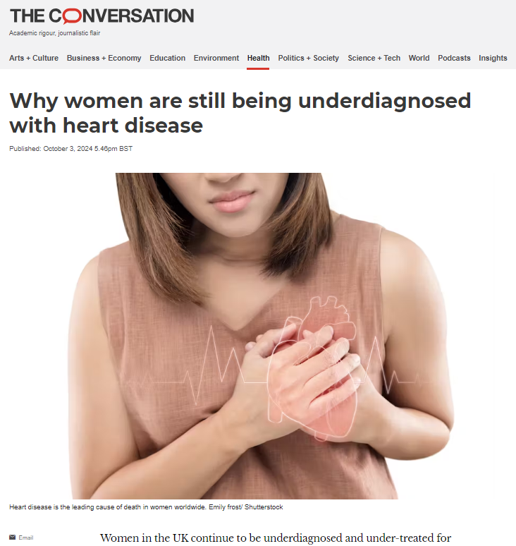
Open the following article: Why women are still being underdiagnosed with heart disease
Notes:
Why women are still being underdiagnosed with heart disease

Slide 7
Before you read… First impressions before reading? (SURVEY): Using only the images and the title, what do you think it will be about? What type of article do you think this will be? e.g. Persuasive/ informative/ explanatory... Write down 10 words associated with the topic: did you find them from skimming the text? Which questions would you like to have answered from reading the text? (QUESTION) Write 3 questions and then find the answers when reading.
Notes:
Why women are still being underdiagnosed with heart disease

Slide 8
Read the article: Why women are still being underdiagnosed with heart disease
Remember your questions.
Make some notes as you read.
Notes:
Why women are still being underdiagnosed with heart disease

Slide 9
Review of reading
The ACE Team
Were your questions answered? Were there any questions that weren’t answered? Tell the group about this. (RECITE)
What was the most interesting point of the article for you?
Was there anything you didn’t understand – an idea or vocabulary? If you had time, would you look up the words you didn’t understand?
Was this article easy to read? What made it easy or difficult? (REVIEW)

Slide 10
Recapping the SQ3R Reading Technique
Survey
Quickly skim the text to get a general idea of what it's about. Focus on headings, subheadings, figures, tables, and summaries.
Question
Create questions about ideas that arise from the survey. For example, if you don't understand a heading, ask a question about it.
Read
Read with the goal of answering your questions. Highlight or make notes on important parts of the text.
Recite
Practice answering your questions out loud. You can also take notes on your answers.
Review
Look back at your questions as you study. You can move the questions off the physical text to help you rely on your own memory.

Slide 11
The ACE Team
Task: reading carefully
You will be split into pairs in breakout rooms:
Answer the following questions together, using the text:
1) What are the 3 main differences between men and women’s hearts?
2) Find 2 reasons why women may be misdiagnosed with heart disease?
Notes:
Task 2: (10 mins)
Breakout rooms – In pairs:
Answer the following questions together, using the text:
What are the 3 main differences between men and women’s hearts?
Find 2 reasons why women may be misdiagnosed with heart disease?
In the whole group: reflect on how easy or difficult it was to find these facts. Did it help that you’d already read the entire article previously?

Slide 12
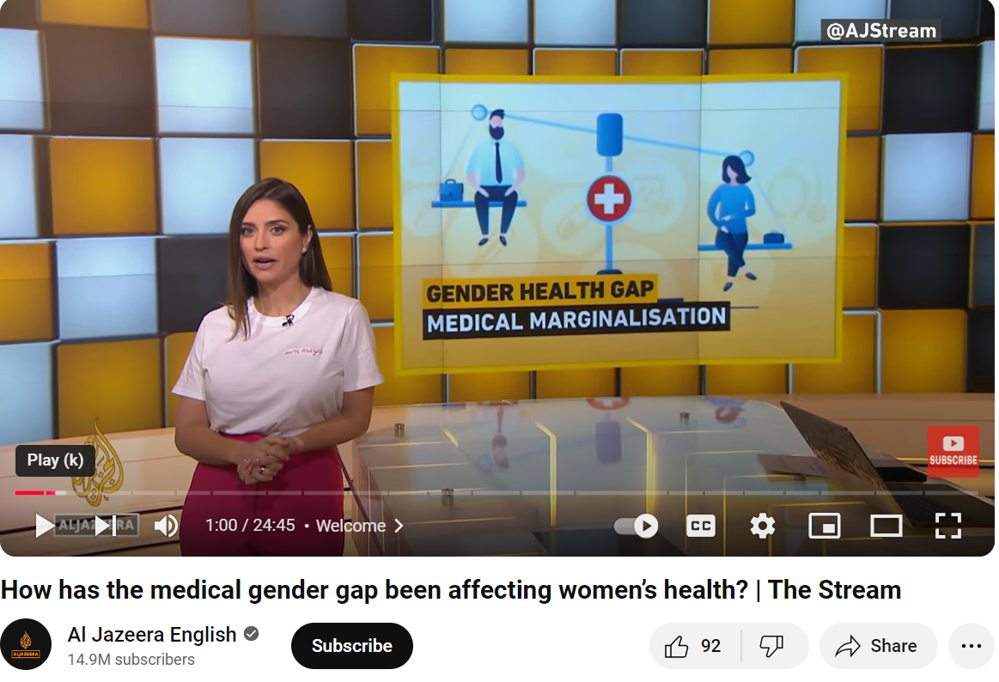
Listening
Listen to a snippet of this video together:
How has the medical gender gap been affecting women’s health? | The Stream
(1.47 – 2.56)
Notes:
How has the medical gender gap been affecting women’s health? | The Stream Don’t share the link until after we’ve listened.

Slide 13
The ACE Team
Listening: review
What is the gender health gap?
What happened in 1993?
Up to how many years later do women receive misdiagnoses?
What are some of the results of overlooking female biology in medical research?
Do you need to listen again? Make some notes this time.
Notes:
Task 2: (10 mins)
Breakout rooms – In pairs:
Answer the following questions together, using the text:
What are the 3 main differences between men and women’s hearts?
Find 2 reasons why women may be misdiagnosed with heart disease?
In the whole group: reflect on how easy or difficult it was to find these facts. Did it help that you’d already read the entire article previously?

Slide 14
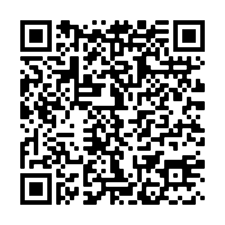
Thank you for attending this session today. We would be grateful if you could take 5 minutes to complete our feedback form.
Via the URL in the Chat Box
https://forms.office.com/Pages/ResponsePage.aspx?id=lwcinDfD-EmwhqmiSXn3KJx4-QmcBv9NnNg4SAsynGNUMDRJTEhHQ1RYSVVMQVZCNjhBMlpMNExDTi4u
By scanning the QR Code
Notes:
https://forms.office.com/Pages/ResponsePage.aspx?id=lwcinDfD-EmwhqmiSXn3KJx4-QmcBv9NnNg4SAsynGNUMDRJTEhHQ1RYSVVMQVZCNjhBMlpMNExDTi4u

Slide 15
References
Al Jazeera English. (2024) How has the medical gender gap been affecting women’s health? YouTube video. Available at: https://www.youtube.com/watch?v=xOFu6wtBjJI (Accessed: 26 November 2024
Quaye, B. (2024) ‘Why women are still being underdiagnosed with heart disease’. The Conversation. Available at: http://theconversation.com/why-women-are-still-being-underdiagnosed-with-heart-disease-240243 (Accessed: 26 November 2024).

