Slide 1
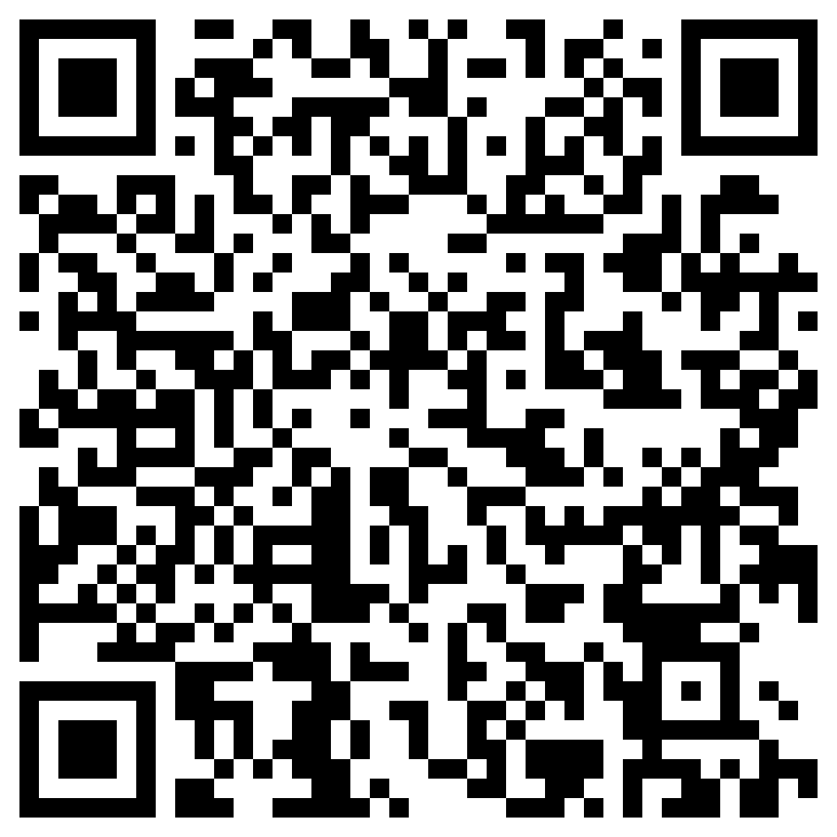
Academic Reading Club Session 2: Strategies to become a more efficient reader
The ACE Team
The session will start at 4.30
Please ensure that your speaker/output settings are correct.
Please ensure that you register for this workshop here:
Study Skills Workshop Attendance Form (office.com)
Notes:
You can access the slides from here: Academic-Reading-Club-Session-1.pptx

Slide 2
Icebreaker: Do you read these texts slowly or quickly?
Read slowly and carefully
Read quickly to get a general idea
How do you read….?
Instructions on how to apply for a job
A social media post
A birthday card
A recipe
A novel (fiction book)
Your assignment instructions

Slide 3
The ACE Team
Topics covered today
Strategies for more efficient reading
Skimming, scanning and reading for detail
Listening skills

Slide 4
Have a reason for reading
Keep your reason in mind when you start searching for and looking at texts to assess their validity and relevance.
Sometimes you will read to:
understand the main points about a topic
find an explanation of a particular concept
find evidence to support a point.

Slide 5
Skimming, Scanning & Reading for detail
Use skimming & scanning techniques to choose the most relevant and useful texts to read more closely.
This is different from the SQ3R technique we explored in Session 1 : more about looking for specific information and having a specific purpose for your reading technique.

Slide 6
Skimming
Useful when you want to survey a text to get a general idea of what it is about and decide whether it is worth reading more closely or not.
Ignore the details and look for the main ideas.
Main ideas are usually found in the first sentences of each paragraph and in the first and last paragraphs.
You can also get a good idea of the overall content of a text by reading the headings and sub-headings first: this should help you get a feeling for the content and organisation of the text.
When skimming, read quickly; don’t stop to check words that you do not know.
Notes:
Skimming is useful when you want to survey a text to get a general idea of what it is about and decide whether it is worth reading more closely or not. In skimming you ignore the details and look for the main ideas. Main ideas are usually found in the first sentences of each paragraph and in the first and last paragraphs. You can also get a good idea of the overall content of a text by reading the headings and sub-headings first. This should help you get a feeling for the content and organisation of the text. When skimming, read quickly; don’t stop to check words that you do not know.

Slide 7
Scanning
Looking for specific key terms or phrases in a text
Your eyes move quickly over the words until you find the particular information you are looking for.
You ignore everything except the specific information you want.
Scanning is directed and purposeful - should be extremely fast.
Notes:
Skimming is useful when you want to survey a text to get a general idea of what it is about and decide whether it is worth reading more closely or not. In skimming you ignore the details and look for the main ideas. Main ideas are usually found in the first sentences of each paragraph and in the first and last paragraphs. You can also get a good idea of the overall content of a text by reading the headings and sub-headings first. This should help you get a feeling for the content and organisation of the text. When skimming, read quickly; don’t stop to check words that you do not know.

Slide 8
Skim, Scan & Read for detail
Skim​ | Quickly read to determine the overall idea of the text. ​
Scan​ ​ | Scan your eyes over the text to locate specific information you need.​ Reading online? Use search function (CTRL + F). ​
Read for detail ​ | Once you have located a useful section, take your ​ time to read carefully and take notes.​ ​
Notes:
Skimming is useful when you want to survey a text to get a general idea of what it is about and decide whether it is worth reading more closely or not. In skimming you ignore the details and look for the main ideas. Main ideas are usually found in the first sentences of each paragraph and in the first and last paragraphs. You can also get a good idea of the overall content of a text by reading the headings and sub-headings first. This should help you get a feeling for the content and organisation of the text. When skimming, read quickly; don’t stop to check words that you do not know.

Slide 9
Open the following article: More young people in the UK are living with parents and grandparents – here’s what you need to know if you’re considering it
Notes:
More young people in the UK are living with parents and grandparents – here’s what you need to know if you’re considering it

Slide 10
1. Skim to determine the overall idea of the text
Notes:
5 minutes

Slide 11
Reflection: Skim
The ACE Team
Did you gain a general sense of the overall idea of the article?
Did the article’s images or headings help with your skimming?
What questions do you have after skimming – could you write them down?

Slide 12
2. Scan Scan to answer the following question: What are some of the main challenges of multi-generational living?
Notes:
(7 minutes)

Slide 13
Reflection: Scan
The ACE Team
Were you able to answer the question?
What are the challenges? (Answer without looking at the article again)

Slide 14
3. Read for detail Find the section on the main challenges of multi-generational living and summarise this in your own words (paraphrase). Write a few sentences (at least three) on the main challenges of multi-generational living. Write full sentences and use academic English vocabulary. Try to use signposting/ connecting words and phrases to link your ideas.
Notes:
(10 minutes).

Slide 15
Evaluating the article
The ACE Team
What did you think of the way the article is written?
Choose one sentence that you found especially effective or well-written. Put it in the chat or read it aloud.
Why do you think this sentence is effective?
Notes:
Think about how the article is written – this is a good idea when you are reading as you can pick up writing tips.

Slide 16
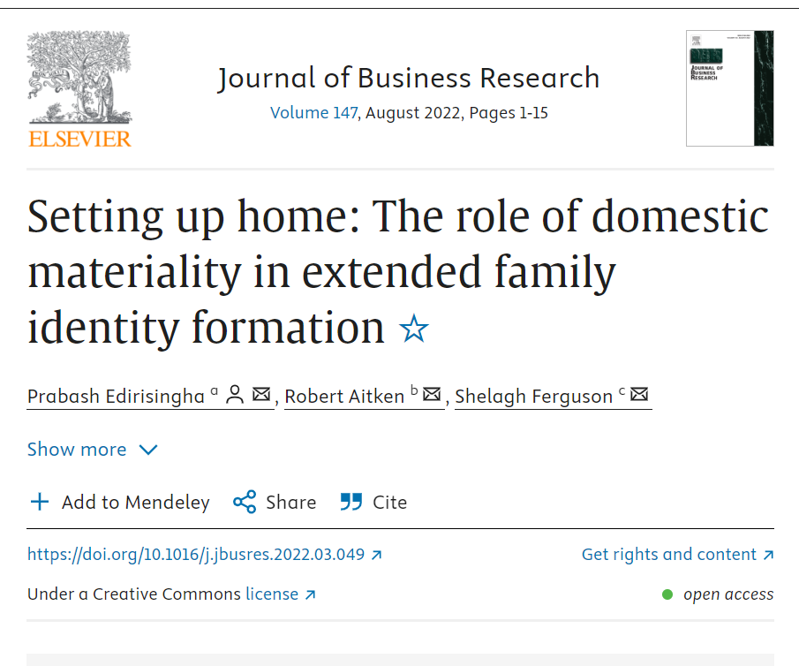
The ACE Team
Academic vs non-academic sources
The Conversation article is based on this journal article: Setting up home: The role of domestic materiality in extended family identity formation - ScienceDirect
Read the abstract
Notes:
Setting up home: The role of domestic materiality in extended family identity formation - ScienceDirect
Vocabulary, detailed amount of data.

Slide 17
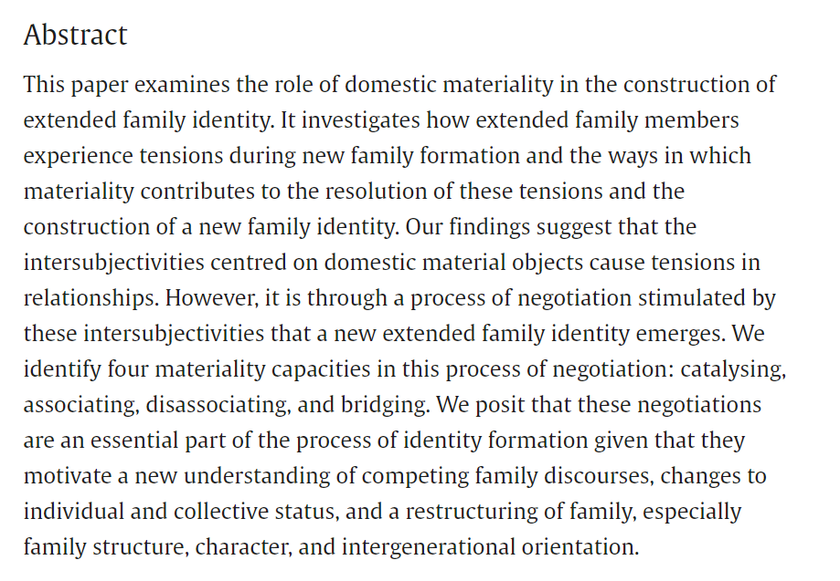
, ,
, ,
The ACE Team
(Edirisingha et al., 2022)

Slide 18
The ACE Team
Academic vs non-academic sources
What do you think is the difference in language, vocabulary and tone between the two articles? Can you give some examples?
Will the journal article have some information that you won’t find in the other article? What kind of information?
Which one would you use for an assignment?
Notes:
Setting up home: The role of domestic materiality in extended family identity formation - ScienceDirect
Vocabulary, detailed amount of data. If time, they can skim the article and find examples to answer these questions

Slide 19
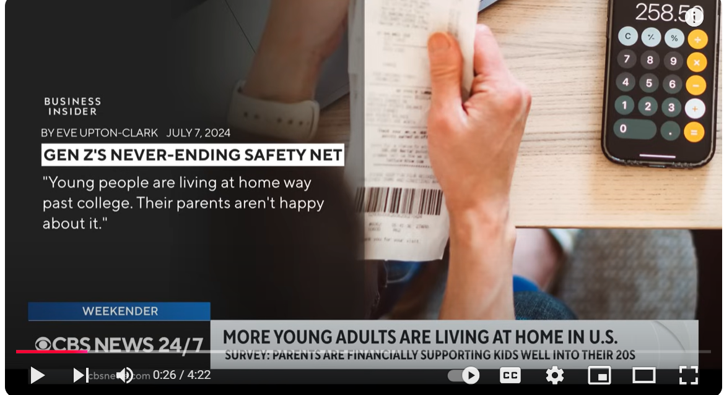
Listening
Listening exercise:
While listening, make some notes on the key points. Also note down any words or expressions you didn’t understand.
More young adults are living at home in U.S., report finds
Notes:
More young adults are living at home in U.S., report finds

Slide 20
The ACE Team
Listening: review
Answer the following questions after listening:
What is ‘emerging adulthood’?
What are some of the financial reasons why adult children are choosing to live with their parents?
What are the financial disadvantages for parents?
Any terms or expressions you didn’t understand?
Notes:
Task 2: (10 mins)
Breakout rooms – In pairs:
Answer the following questions together, using the text:
What are the 3 main differences between men and women’s hearts?
Find 2 reasons why women may be misdiagnosed with heart disease?
In the whole group: reflect on how easy or difficult it was to find these facts. Did it help that you’d already read the entire article previously?

Slide 21
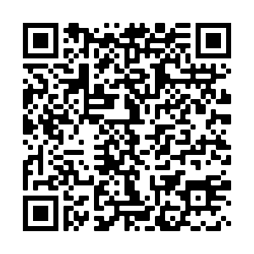
Thank you for attending this session today. We would be grateful if you could take 5 minutes to complete our feedback form.
Via the URL in the Chat Box
https://forms.office.com/Pages/ResponsePage.aspx?id=lwcinDfD-EmwhqmiSXn3KJx4-QmcBv9NnNg4SAsynGNUMDRJTEhHQ1RYSVVMQVZCNjhBMlpMNExDTi4u
By scanning the QR Code
Notes:
https://forms.office.com/Pages/ResponsePage.aspx?id=lwcinDfD-EmwhqmiSXn3KJx4-QmcBv9NnNg4SAsynGNUMDRJTEhHQ1RYSVVMQVZCNjhBMlpMNExDTi4u

Slide 22
References
CBS News (2024) More young adults are living at home in U.S., report finds. YouTube video. Available at: https://www.youtube.com/watch?v=D9Q7n0pJEeM (Accessed: 26 November 2024).
Edirisingha, P. (2023)’More young people in the UK are living with parents and grandparents – here’s what you need to know if you’re considering it’. The Conversation. Available at: https://theconversation.com/more-young-people-in-the-uk-are-living-with-parents-and-grandparents-heres-what-you-need-to-know-if-youre-considering-it-216280(Accessed: 26 November 2024).
Edirisingha, P., Aitken, R. and Ferguson, S. (2022) ‘Setting up home: The role of domestic materiality in extended family identity formation’, Journal of Business Research, 147, pp. 1–15. Available at: https://doi.org/10.1016/j.jbusres.2022.03.049.

